Slide 1
Draft Foreign Subsidies Implementing Regulation: the path for enforcement
GCLC 130th Lunch talk
3 March 2023
Martin Farley
European Commission, Legal service
[speaking in a personal capacity]

Slide 2
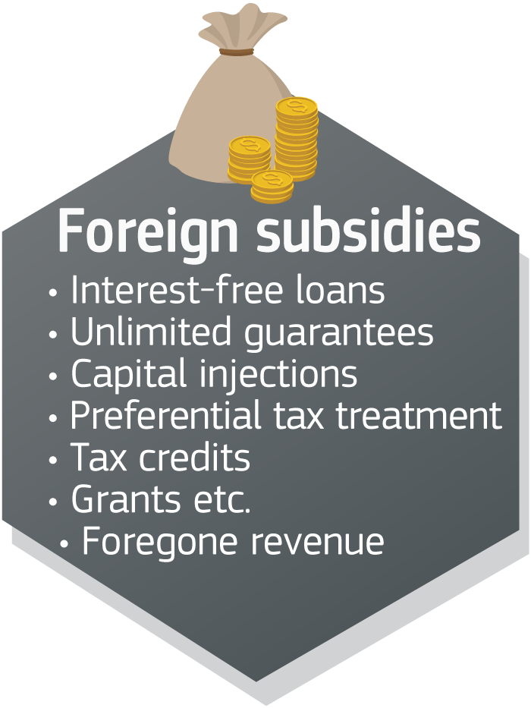
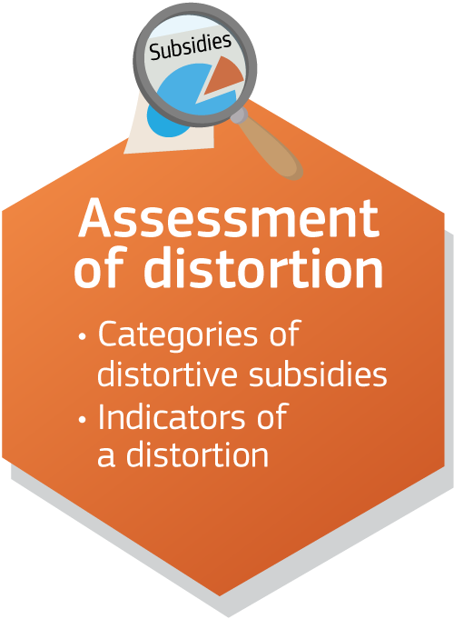
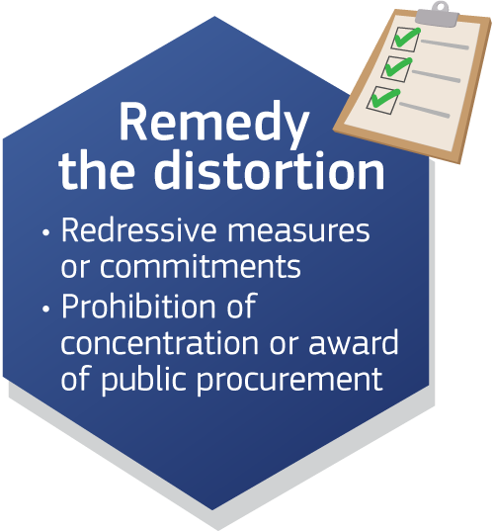
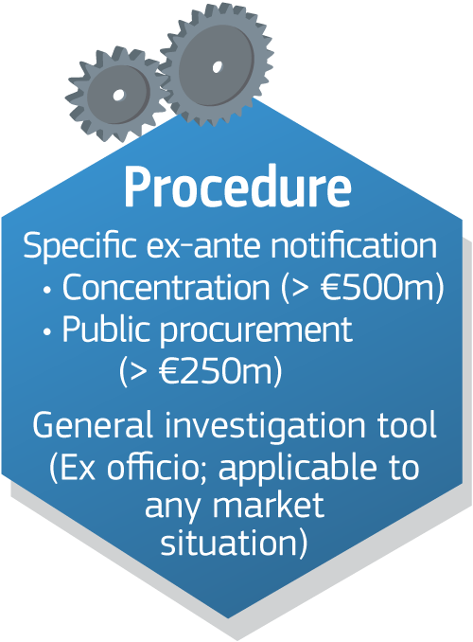
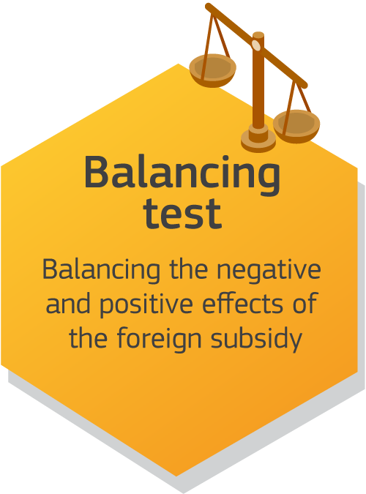
The agreed Regulation at a glance

Slide 3
The draft Implementing Regulation (1)
Procedural rules for three procedures set out in FSR
Ex officio
Concentrations
Public procurement bids
Inspired by procedural rules for mergers, antitrust and State aid

Slide 4
The draft Implementing Regulation (2)
9 chapters
Scope and definitions (chapter I),
Notifications and transmission of documents (chapters II and IX)
Investigation by the Commission (chapter III)
Commitments and redressive measures (chapter IV)
Submission of observations (chapter V)
Use of information, confidential information and access to file (chapter VI and VII)
Time limits (chapter VIII)

Slide 5
The draft Implementing Regulation (3)
Notification and transmission of documents (Chapters II and IX)
How and by whom
Digital transmission of documents as rule
Investigation by the Commission (Chapter III)
Submission of views following opening of the in-depth investigation
Interviews
Oral statements during inspections

Slide 6
The draft Implementing Regulation (4)
Commitments and redressive measures (Chapter IV)
Time limits for submission of commitments
Procedure
Monitoring trustee
Transparency and reporting obligations

Slide 7
The draft Implementing Regulation (5)
Submission of observations on grounds on which the Commission intends to adopt its decision (Chapter V)
Submission of observations in writing
No oral hearings
Safeguards to guarantee rights of defence
Observations on grounds
Access to file
Possibility to submit written observations: (i) after opening of in-depth investigation; and (ii) after receipt of “grounds”

Slide 8
The draft Implementing Regulation (6)
Use of information (Chapter VI)
possibility for information to be used for other purposes, subject to authorisation
Treatment of confidential information (Chapter VI)
power to take decisions where it is not possible to reach an agreement on confidentiality
Access to file (Chapter VII)
non-confidential versions of the documents included in the grounds
flexibility for setting A2F for other documents (e.g. confidentiality rings, data rooms, classical A2F etc.)

Slide 9
The draft Implementing Regulation (6)
Calculation of time limits (Chapter VIII)
Possibility to suspend time limits
Notifying parties fail to provide (complete) information
Third parties fail to provide (complete) information owing to circumstances for which the parties are responsible
Refused to submit to an inspection
Failed to inform Commission of relevant information – including change of facts

Slide 10
The draft Implementing Regulation (7)
Provisions specific to public procurement:
Submission of notification or declaration (of no notifiable foreign financial contributions – same form)
Notification in the language of the public procurement procedure
Right of Contracting Authorities / Contracting Entities to clarify notification/declaration and reject if not clarified as prelim. step
Obligation for CA/CEs to send documents it considers crucial for the investigation
Suspension of time limits only in multi-stage procedures, until submission of the (final) tender

Slide 11
Draft notification form for large concentrations (1)
‘Administrative sections’ are similar to Form CO as used in EU merger control
Sections 1-3 and 8
Description of concentration, info about parties to the concentration, supporting documentation
2. Notification thresholds (Section 4)
Target (or JV / merging party)
is established in the Union; AND
generates an aggregate turnover in the Union of at least EUR 500 million; AND
The acquirer and the target were granted combined aggregate financial contributions of more than EUR 50 million in the preceding three years

Slide 12
Draft notification form for large concentrations (2)
3. Foreign financial contributions (Section 5):
List of financial contributions granted over the past three years meeting two cumulative conditions:
(i) an individual amount ≥ 200,000 EUR; and
(ii) an aggregate amount per 3rd country per year ≥ EUR 4 million;
More detailed information in notification form only for subset of financial contributions, namely financial contributions likely to fall in one of the categories (i.e. most likely to be distortive)
If needed, Commission services can gather additional information through information requests

Slide 13
Draft notification form for large concentrations (3)
4. Impacts (section 6)
Concentration in the context of a structured bidding process?
Economic and business rationale of the concentration?
Improved economic activity of notifying parties after concentration?
Merger control or other filings in the EU?
Benefits to operation of new entity on the IM?
5. Balancing test (Section 7)
Identify possible positive effects

Slide 14
Draft notification form for public procurement
Similar when possible to the Concentrations form, with notable differences.
Sections 1 and 2 –description of the public procurement, info about the notifying parties
Section 3 – information requirements for financial contributions. More detailed information required upfront than in concentrations form (no stop the clock)
Section 4 – possibility (no obligation) to justify the absence of undue advantage of the tender
Section 5 – positive effects (corresponds to Section 7 of the Concentrations form)
Section 6 – requirement for supporting documents (can be detailed – parts optional)
Section 7 – declaration that there are no notifiable foreign financial contributions; in that case sections 3-6 are left empty. A list of received non-notifiable contributions needs to be provided.

Slide 15
Thank you
© European Union 2020 Reuse of this presentation is authorised under the CC BY 4.0 license.
Notes:
Update/add/delete parts of the copy right notice where appropriate.
More information: https://myintracomm.ec.europa.eu/corp/intellectual-property/Documents/2019_Reuse-guidelines%28CC-BY%29.pdf

