Slide 1
What role for the courts in the post-modernisation era? The role of national courts: a view from the Bench Ingeborg Simonsson, Judge of Appeal, Svea Court of Appeal and the Patent and Market Appeal Court, Sweden, Associate professor in European law, Stockholm University
Presentation for the 17th GCLC ANNUAL CONFERENCE 25-26 March 2022 COLLEGE OF EUROPE, BRUGES

Slide 2
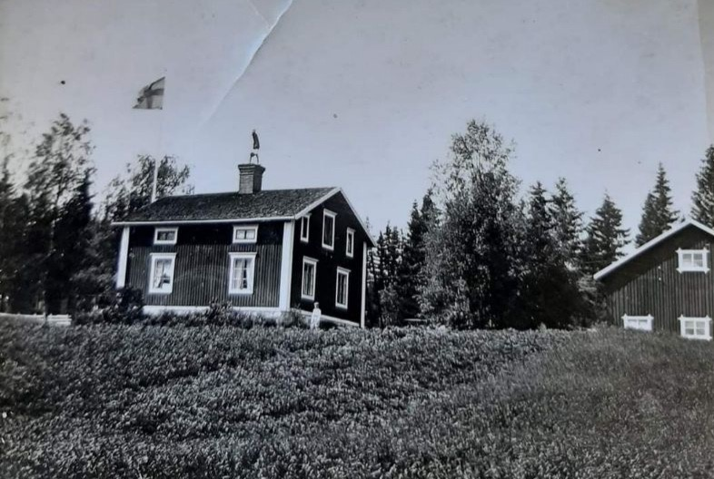
Does it have to be so difficult?

Slide 3
Cases are becoming increasingly voluminous and complex
By way of illustration, let’s take a backward-looking glance at a stand-alone damages case where the judgment was handed down on 20 November 2008 (Stockholm City Court Case no 32799-05, the VPC-case, see the Oxera Study “Quantifying antitrust damages, 2010, at p 23).
A full trial in open court over some three days, a judgment at first instance with finding of dominance and abuse, award of quantified damages
The action of the parties was described in 10 pages and the reasoning of the court was another 10 pages. The judgment was for the most part upheld on appeal two years later, although the damages were reduced.

Slide 4
Fast forward to 2017 when two follow-on damages cases were quashed on the merits by Svea Court of Appeal (case no 2673-16 and case no 5365-16).
There had been a finding of an abuse of dominance through margin squeeze by the highest national instance (the Market Court) in 2013, case no 8/11, see also the preliminary ruling in Case C-52/09.
In the first of the follow-on cases, Svea Court of Appeal in 2017 made a finding of no abuse because of absence of effects, in spite of negative margins, and dismissed the action fo damages on the merits (case no 2673-16)
In the second case, Svea Court of Appeal found that there had been an abuse, but dismissed the damages action on the merits because of absence of causality (case no 5365-16).
Leave for appeal was denied by the Supreme Court in 2018.

Slide 5
Compatible with EU law?
Case C-724/17 Skanska Industrial Solutions and Others and Case C-637/17 Cogeco Communications:
One may question whether evaluation of evidence under national law must be reconsidered in order to meet the requirement of effectiveness of Articles 101 and 102 TFEU (see in particular Skanska at para 46 and Cogeco at paras 41 and 44).
Must the assessment of causality under national law be reconsidered in order to meet the said requirement?

Slide 6
What happened between 2008 and 2017?
Over 20 damages cases were brought before Swedish courts or proceedings were closed during the said period. The majority of the cases were settled. The few that went to trial were dismissed on the merits.
The TeliaSonera follow-on damages cases were won at first instance in 2016 (although those judgments were reversed on appeal)
The damages directive was implemented in Sweden in late 2016, Konkurrensskadelag (2016:964)

Slide 7
….
Meanwhile, the Swedish Competition Authority was having a hard time winning its cases before the Swedish Courts (see the Report Konkurrensverkets domstolsprocesser, 2021, by professor Torbjörn Andersson and docent Magnus Strand, available at www.konkurrensverket.se).
This could have had a chilling effect nationally and made the jurisdiction attractive for actions for negative declaratory judgments
Over the same period of time, cases brought in other Member States could be counted in the hundreds (see Laborde, Jean-François, Cartel Damages Actions in Europe: How courts have assessed overcharges (2021 ed.), Concurrences N° 3-2021.

Slide 8
The cases are becoming more and more voluminous and complex
Already when a damages case is brought in recent years, you can see the sure signs that it will be a voluminous and lengthy case
Along the way, many decisions must be adopted on preliminary questions such as jurisdiction of the court, evidentiary issues, statutory limitation periods and the like.
As a result, the fees to counsel are increasing with increased workload
Can a small or medium size enterprise today realistically bring a competition law damages case?

Slide 9



