Slide 1

17th GCLC ANNUAL CONFERENCE
THE TRANSFORMATION OF EU COMPETITION LAW:
NEXT GENERATION ISSUES
25-26 March 2022
COLLEGE OF EUROPE, BRUGES
Panel 5 - The transformation of State aid law and policy: modernisation relaunched and the link with crisis management
Should we adapt the centralised enforcement system in the new era?
Jacques Derenne
Partner, professor, University of Liège, GCLC

Slide 2
Outline
Where are we coming from?
What is the true recent “revolution”?
Recent illustrations confirming the initial wisdom of 1957:
  a supranational, independent, exclusive authority: the European Commission
  this is consubstantial to State aid control
  ousia (Ancient Greek: οὐσία): the essence or substance.

Slide 3
Where are we coming from?

Slide 4
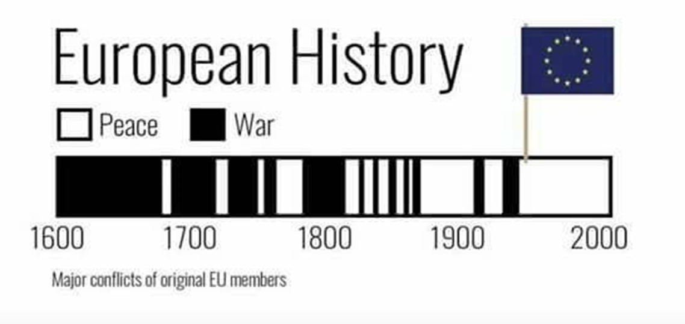
History
Bosnia
Ukraine…

Slide 5
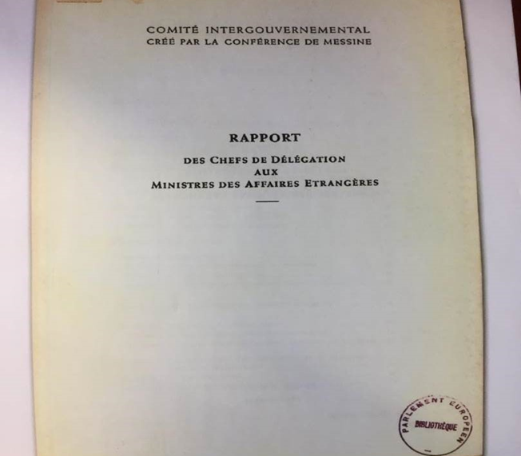
Spaak Report (1)
State economic operator v State regulator
European integration
  1955 Messina – 1956 IG Conference
  1956 Spaak Report
    Completion of the ‘common market’
    Two types of competition distortions
      Artificial advantages granted by Member States
      Discrepancies in national legislation and regulations
    Preventing Member States from engaging in
      Subsidies race
      Export aid
      Protectionism

Slide 6
Spaak Report (2)
page 16 : « Le deuxième fait, c’est l'intervention étendue des Etats en vue de favoriser les entreprises de leur nationalité. Il faut donc discerner les aides utiles à l'intérêt général et à l'expansion de la production de celles qui ont pour objet et pour effet de fausser la concurrence ».
page 57 : « Une des garanties essentielles qui doivent être données aux entreprises, c'est que le jeu ne risque pas d'être faussé par les avantages artificiels dont bénéficieraient leurs concurrents. Les aides accordées par les Etats doivent donc être examinées de très près, indépendamment de la forme extérieure qu’elles revêtent».
page 58 : « Le discernement entre les diverses formes d'aides, suivant leur effet économique et leur opportunité pour la réalisation progressive et sans heurts du marché commun, doit être confié à la Commission européenne à laquelle elIes devront être notifiées par l'Etat intéressé, mais qui pourra aussi entreprendre l'examen approprié sur la base des informations qu’elle se procurera elle-même ou sur demande d’un autre Etat ».

Slide 7
The EU system
Supranational independent authority to control State aid granted by Member States
Ex ante control (Article 108(3) TFEU)
State aid control is part of competition policy: competition between Member States and competition between undertakings
EU market integration: central objective (link with internal market)
Public policy objectives of Member States v distortion of competition
  Negative spill-overs on other Member States
  Undermines functioning of internal market
  Need for a balance: rationale for the EU State aid control
    Economic gravitation (obstacles to trade linked to potential of trading)
    Propensity of trading partners to subsidise (relative budgets, “national champions”)
    Market failures (efficiency)

Slide 8
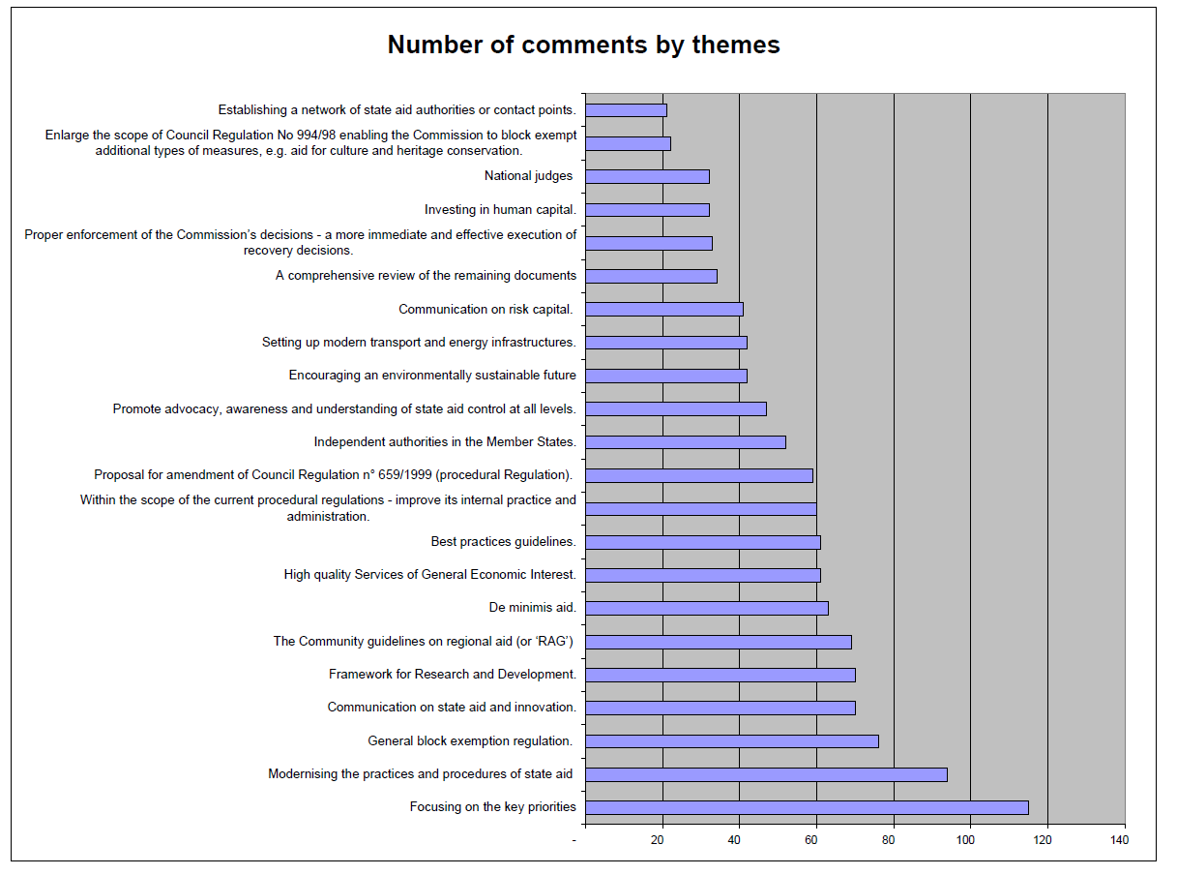
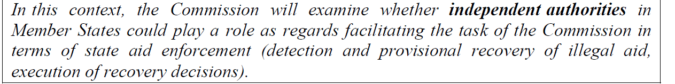
State aid action plan (SAAP) 2005
Independent authorities in the Member States - controversy

Slide 9
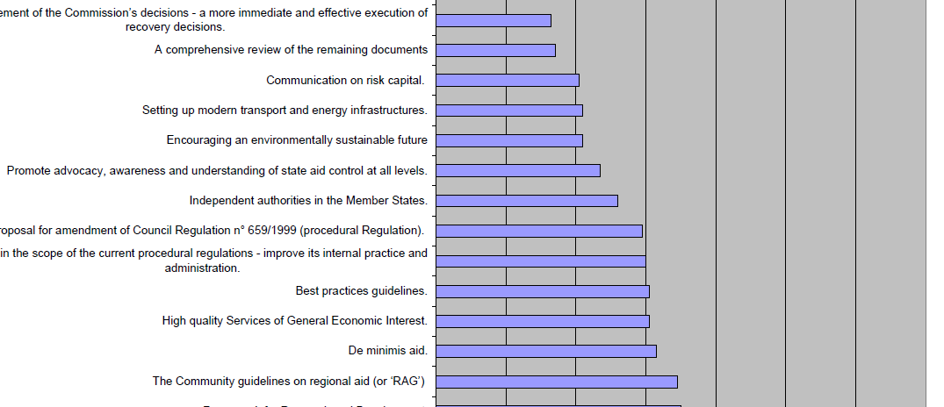
State aid action plan (SAAP) 2005
Independent authorities in the Member States - controversy

Slide 10
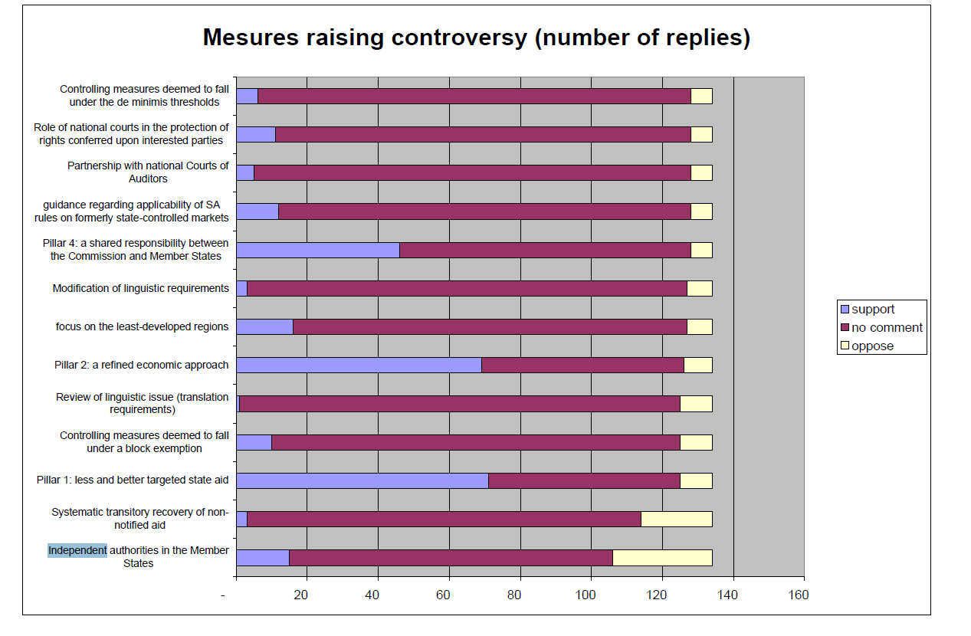
SAAP 2005
Measures raising controversy:

Slide 11

SAAP 2005
Measures raising controversy: general support ratio = -30%
15 in support, incl. 5 MS and 1 region
28 oppose, incl. 8 MS, 8 regions and business associations

Slide 12
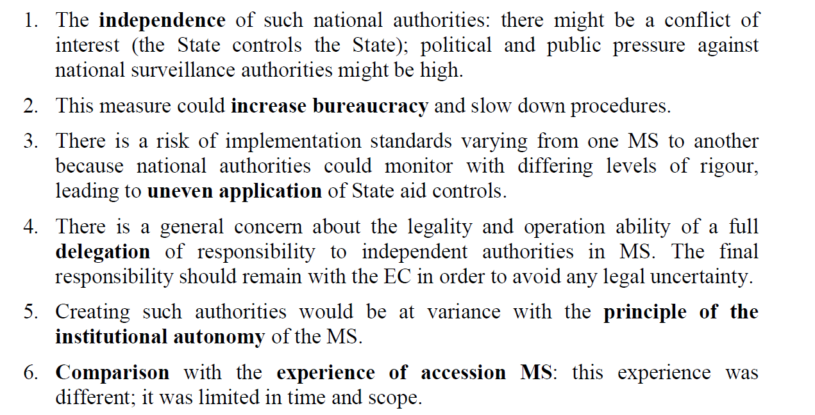
SAP 2005
Results of the comments against independent MS authorities:

Slide 13
Some comments in 2005 (1)
At a conference in Copenhagen in the late 1990s, when the State Aid Procedures Regulation came into force, the European Courts of Auditors themselves rejected the EC's suggestion that they should be entrusted with state aid control functions (Austria)
The Dutch authorities remain supportive of a strong central role for the European Commission in the area of state aid control policy (The Netherlands)
the Treaty rules provide for very specific powers for the EC, which cannot therefore be attributed to other bodies (Italy)
[The MS] would not be aware of all the cases under discussions by the national authorities and are not equipped to monitor such activity (UK)
the Commission [is] the competent authority in state aid matter according to the treaty, and […] this competence cannot and must not be delegated to other authorities (Lux)
[…] insist on the importance of the Commission's exclusive competence to assess aid schemes (DK)

Slide 14
Some comments in 2005 (2)
There is a clear conflict of interest when the state controls the state. State aid is very often awarded as the result of a political process. Political and public pressure against national surveillance authorities might be high. Any political or public pressure could be particularly high if the national authorities were to be entrusted with discretionary competence. A decentralisation [...] could lead to different practices in the 28 EEA Member States. There is not only the question of whether national authorities in fact are independent or not – the competitors of an undertaking suspected of having received illegal sate aid and the public in general must also be able to have confidence in the independence of a national surveillance authority. (NOR)
The government categorically rejects the Commission's proposal to establish independent state aid monitoring authorities in the Member States. An obligation under Community law to establish such authorities would neither make political sense nor be legally acceptable (GER).

Slide 15
SAM 2012
The idea of independent national authorities was abandoned

Slide 16
2. “Revolution”: from ex ante to ex post?

Slide 17
More GBER, less notifications, less ex ante
Before SAM
  < 50% of measures and about 32% of spending under GBER
After SAM
  +95% of (new) measures and about 65% of spending under GBER
  drastic reduction of notifications (from 578 in 203 to ~150 in 2019 before Covid)
State aid control became “ex post control” in most of the cases, but not for the most serious ones
GBER can be regarded as collective “ex ante” control
However, GBER “rigidifies” State aid actions

Slide 18
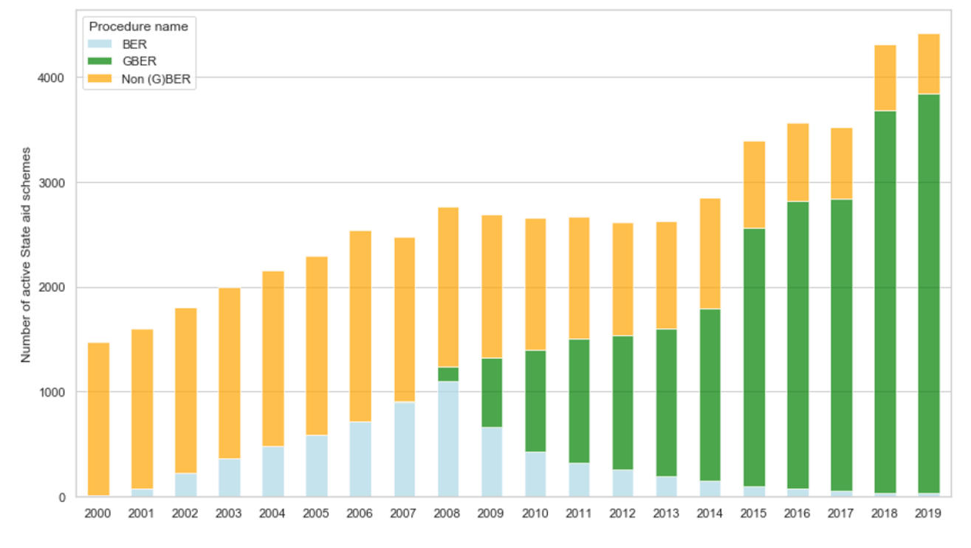

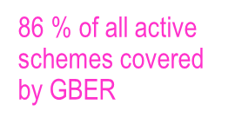
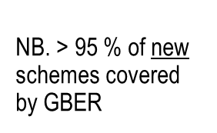

Progressive extension of GBER (1)

Slide 19
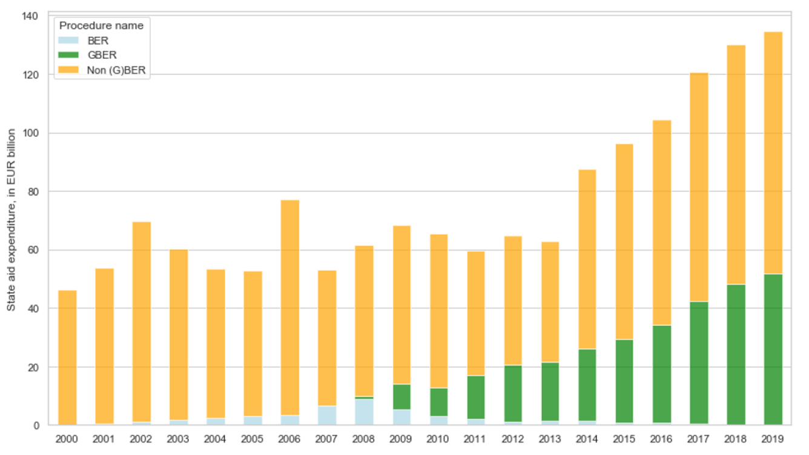
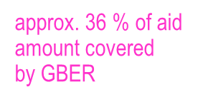
Progressive extension of GBER (2)

Slide 20
3. Recent events confirmed the vision and wisdom of the Founding Fathers in 1957
Financial crisis, Covid-19 crisis and Ukraine war crisis
  Neelie Kroes and Ministers of Finance in October 2008
  need for centralised EU vision, coordinated actions
  adjusted procedures and rules but strong ex ante control
  “avoid a jungle without a level playing field” (N. Kroes, 2008)
ab absurdo: Brexit (TCA and UK Subsidy Bill)
  CMA (“independent body” under the TCA, Subsidy Control Unit under the CMA) & devolved administrations
  judicial review (apart from decisions contained in primary legislation of the devolved or Westminster parliaments)
Foreign subsidies proposal – consultation/final proposal
  Module 1 - some MS: sharing responsibilities MS/Commission based on thresholds; majority of other EU stakeholders: Commission exclusively responsible; if shared enforcement responsibilities, strong leadership by the Commission.
  Module 2 - majority of EU stakeholders: exclusive Commission power.
  Module 3 - MS: Commission should have exclusive powers for assessing whether a foreign subsidy is distortive, in the interest of consistency and legal certainty.
  Results: prior, suspensive, mandatory notification to the Commission, ex officio investigation powers exclusive to the Commission, exclusive powers to the Commission with a view to imposing effective remedies or to prohibiting the relevant business actions.

Slide 21
Conclusions – Way forward
No decentralisation (contrary to the essence of State aid control), but:
More resources for DG COMP, more powers (similar to antitrust), improved Procedural Regulation (blocked by MS)
Better national enforcement (progress made but still efforts to be made)
Harmonised procedures for national enforcement (see antitrust damages directive – and State aid?)
More deterrence on Member States and beneficiaries (unlawful aid)
More prevention and detections tools (independent national State aid commissioners with preventive powers against unlawful aid, in particular by legislator)

