Slide 2
Library skills
HOW TO FIND A MASTER THESIS

Slide 3
How TO FIND A MASTER THESIS
You want to have a look at the thesis's written for your department.
Before you start
A thesis which got less than 15/20 is not at the library
If a student did not grant us permission, it will not be available
If the department, did not grant us permission, it will not be available
A thesis is only available digital
Last year theses are available from mid-October onwards

Slide 4
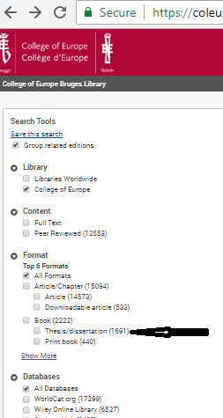
How to FIND A MASTER THESIS
You can narrow your research further by adding your supervisor’s last name, year of publication, you can put your search string in the search box
You also can use the menu on the left side of the screen

Slide 5
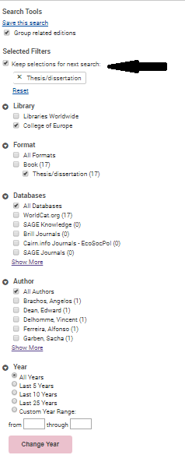
How to find a master thesis
2.
1.
Use the filter
“thesis/dissertation” on the left menu bar.
2. When you press enter,
your specifications will be saved on top in the ‘selected filters’.

Slide 6
How to find a master thesis
When you have made your choice, click on de title, the following screen will appear
Click on view ebook
At the bottom you will find a link to the pdf

Slide 7
How to find a master thesis
Thank you for following this presentation.
If you have any questions or suggestions for other presentations to facilitate your library experience :
Feel free to contact me :
renee.maeyaert@coleurope.eu

