Slide 1
Thomas Kramler, DG COMP
The views expressed are not necessarily those of the Commission
AT.40437
Apple- App Store practices (music streaming)

Slide 2
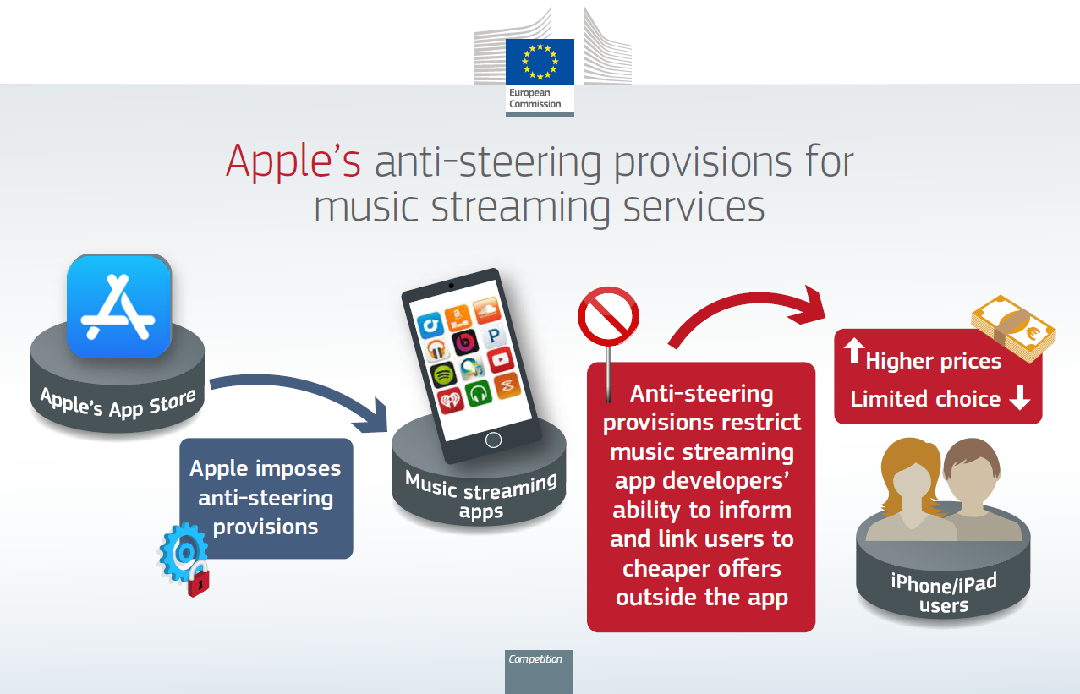

Slide 3
Anti-steering provisions
Distribution of digital content on iOS apps (incl. music streaming services):
Mandatory use of Apple’s proprietary in-app purchasing mechanism (IAP)
30% commission fee (15% after 1 year of uninterrupted subscription)
Multiplatform and reader rules allow subscriptions purchased elsewhere to be consumed in the iOS app → limited by anti-steering (AS) provisions
AS provisions prevent developers from:
Informing users within the app about alternative subscription channels (incl. prices or any indication on how to purchase subscriptions outside the app)
Including links or buy buttons in their app redirecting users to alternative purchasing mechanisms
Sending outside of the app communications (e-mails) following “calls to action”
Only a minority of developers (around 16%) are subject to these rules (incl. the fee)

Slide 4
Market definition and dominance
3 markets identified: smart mobile devices, distribution platform for music streaming apps to iOS users and music streaming services
Dominance in the market for the provision to developers of platforms for the distribution of music streaming apps to iOS users (i.e. developer side of the App Store)
App Store is a multi-sided platform with two user groups:
Developer side (relevant side - dominance)
Consumers side (potential constraint on developer side; similar to an aftermarket)
App Store is the only channel to distribute native apps (100% market share); high barriers to entry (prohibition of sideloading and alternative app stores); network effects and limited countervailing buyer power
Limited constraints from:
The consumer side of the platform
Alternative subscription mechanisms for music streaming services outside of the iOS app

Slide 5
Legal test
Exploitative and focused on harm to consumers
AS provisions constitute unfair trading conditions under Article 102(a) TFEU
The test
AS provisions unilaterally imposed by Apple on trading partner (music streaming developers)
AS provisions detrimental to the interest of a third party (iOS users)
Require music streaming developers to hide highly relevant information from iOS users and prohibit link outs to purchase subscriptions outside the app
Affect parameters of competition such as price, choice, quality or innovation to the detriment of the interests of consumers
AS provisions not necessary for the achievement of a legitimate objective and in any case, not proportionate

Slide 6
Harm to consumers
Monetary harm: iOS users subscribing in-app pay higher prices for their MS premium plans (2-3 EUR +)
Music streaming providers pass-on the cost of the commission fee to consumers
At least 1.4 million iOS users overpaid for premium subscriptions
Non-monetary harm: MS providers have disabled IAP (Spotify, since 2016) - limited choices, degraded iOS user experience and consumer frustration
21% of Spotify iOS users did not manage to subscribe due to misinformation
In 2022: 3.9 million Spotify users got lost in the subscription process and 15 million Spotify users went through inferior user experience
No finding of harm to developers, but the decision acknowledges negative impact

Slide 7
Necessity and Proportionality
What is the purpose of the AS provisions?
As defined by Apple: avoid circumvention of the obligation to pay Apple the commission fee
Necessity and proportionality assessment:
Business choice made by Apple allowing the use in-app of subscriptions purchased outside of the app pursuant to reader/multiplatform rules → no circumvention, as the possibility to buy subscriptions outside of the app already exists
AS provisions also not necessary to finance the App Store: Apple could still charge for the sale of subscriptions made by users through IAP in full knowledge of their options; music streaming apps play small role in financing whole App Store operation
No proper balance of interest; in particular iOS users cannot exercise effective choice within their expensive iPhones

Slide 8
Fine and remedy
DMA
Fine: 40 million EUR (standard fining methodology) + 1.8 billion lump sum
Duration: (June 2015- ongoing)
Remedy: cease and desist order, limited to anti-steering and music streaming
Many relevant DMA obligations: 5(4), 5(5), 5(7) in-app payments, 6(4), 6(12)
DMA will provide for free of charge steering for all developers (debate around first acquisition)
Non compliance proceedings opened as regards steering

Slide 9
Thank you!

