Slide 1
The EU framework for FDI Screening
Regulation (EU) 2019/452 of the European Parliament and of the Council of 19 March 2019 establishing a framework for the screening of foreign direct investments into the Union
Damien LEVIE
Tech & Security, FDI Screening – DG TRADE
20 Sept 2023

Slide 2
Fundamental elements of the EU framework on FDI Screening
Security & Public order FDI screening is not about competitiveness or economic sovereignty.
EU screening is complementary It does not replace MS screening. Final decision rests with MS.
Confidentiality is paramount Strong requirements in the Regulation.
Notes:
Let’s be clear on some fundamental points.
Focus of the entire mechanism is security and public order. This is not about supporting EU’s competitivity or ensuring economic sovereignty or protecting sectors that are deemed strategic. This is a not a judgement about those other policy objectives, but this specific tool – the FDI Screening Regulation – is about security/public order. Not more but not less. Against this backdrop, the EU will take care of two main aspects – this is its own added value:
Impact of the investment on more than one EU MS..
Risk for projects/programmes of EU interest .
--- Not screening only on grounds of security and public order would risk to put us at odds with our international commitments (GATS, FTAs…).
The Regulation complements, rather than replaces EU MS screening
Additional layer of screening (in light of added value just explained).
EU MS screening mechanism still and continue to applies.
Key aspect: at most the Commission can issue an opinion / make some recommendations and suggestions but the ultimate responsibility rests with EU MS. It is the decision of the MS to allow/block the investment of propose mitigating measures.
There are strict rules in place in terms of confidentiality:
Information received in the process of screening need to be handled accordingly (need to know basis and only for the purpose of the Regulation) – hence no communication on cases or even on number of cases.
Security clearance for the team (potential use of EUCI).
Status of possible Opinions, at least EU Restricted (in RUE).

Slide 3
Objectives
Transparency: awareness and exchange of info
Added-value: cross-border risks and EU programmes
Requirements for national screening mechanisms
Notes:
Need of transparency; key to assess risk is to be aware. Difficult without an EU instrument. Primary objective of the Regulation is to provide transparency and exchange of information. Before the regulation: did not know.
Adress gaps and loopholes – the added value of the Regulation:
With the internal market, there is no such thing as a purely local or national investment. With integrated markets, supply chains, interconnectedness, the cross-border impact is current, but was not sufficiently looked at.
MS screen in respect to their own national security – do not take into account national security risk of other MS. Hence, no protection of assets that could be critical at EU level.
No specific mechanism to assess risk for EU programmes and projects.
--- Covid pandemic: EU communication in particular context: health sector fragile; undervaluation in time of economic crisis : higher risk for hostile investments.
Lay down basic requirements for EU MS screening mechanism.
Rules and procedures shall be transparent (trigger for screening, grounds for screenings shall be transparent)
Timeframes shall take into account those of the Regulation
Confidential information shall be protected
Possibility of recourse for the investor
Prevent circumvention
Notification to COM of their N screening mechanism

Slide 4
What are we talking about?
A Foreign Direct Investment…
Definition based on ECJ jurisprudence: an investment of any kind; establishing or maintaining lasting and direct links ; in order to carry on an economic activity in a Member State. No Portfolio investment; no Intra-EU investment
… screened by a Member State…
If a Member State screens an investment, it is notified to other Member States and the Commission, which will also screen.
… or not.
The Commission / the Member states can screen transactions that are not screened by the Member State where the investment takes place.
Notes:
WHAT?
FDI – not portfolio investment, not reorganization, Foreign (Circumvention =
investments from within the Union by means of artificial arrangements that do not reflect economic reality and circumvent the screening mechanisms and screening decisions, where the investor is ultimately owned or controlled by a natural person or an undertaking of a third country.
All sectors. All countries (non EU; includes EEA)
Screened by MS – notification ; article 6
Or not – ex officio, article 7

Slide 5
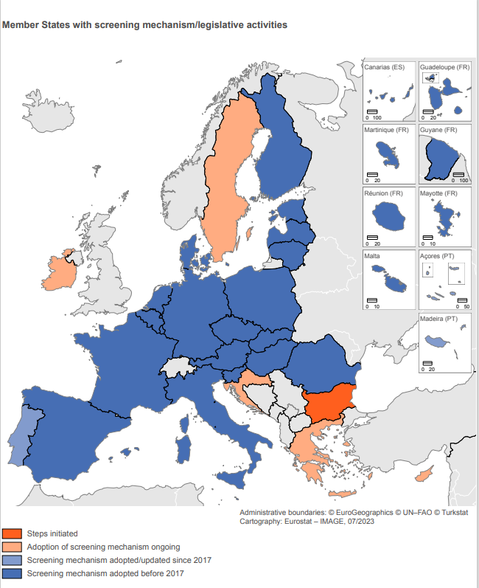
The front office: Member States
Member States are authorised and strongly encouraged to set up or maintain a screening mechanism (no legal obligation)
As of today 21 MS have a screening mechanism in place
Notes:
Member States are at the heart of the EU framework, as they receive the notifications by investors, which they subsequently screen. In that sense, they are the front office / the front door of the EU Cooperation Mechanism.
The EU Screening Mechanism complements, rather than replaces EU MS screening:
Additional layer of screening, but MS screening mechanisms continue to apply
Key aspect: At most, the Commission can issue an opinion / make some recommendations and suggestions but the ultimate responsibility rests with EU MS. It is the decision of the MS to allow any investment – if needed with mitigating measures, or, in exceptional cases, to block it.
As of 1 August 2023, 21 of the 27 Member States have a Screening Mechanism in place, either on a broader level or sector-specific.
From 1 August 2023:
21 Member States with a screening mechanism: MT, FR, AT, PL, LT, PT, DE, CZ, IT, DK, HU, LV, RO, NL, SK, SV, ES, FI, +BE, LX, EE
5 Member States in the process of creating a screening mechanism:, Croatia, Cyprus, Greece, Ireland, Sweden
1 MS initiating steps to adopt one: BG
Member State FDI Screening Mechanism Adopted FDI Screening Mechanism Notified to Commission
Date of entry into force
1 CZ – Czechia YES YES
2 DK – Denmark YES YES
3 DE – Germany YES YES
4 ES – Spain YES YES 5/7/2023 (amendment)
5 FR – France YES YES
6 IT – Italy YES YES
7 LV – Latvia YES YES
8 LT – Lithuania YES YES
9 HU – Hungary YES YES
10 MT – Malta YES YES
11 NL – Netherlands YES YES 1/06/2023 (amendment)
12 AT – Austria YES YES
13 PL – Poland YES YES
14 PT – Portugal YES (but no notifications) YES
15 RO – Romania YES YES
16 SI – Slovenia YES YES
17 SK – Slovakia YES YES
18 FI – Finland YES YES
19 BE - Belgium YES NO (not yet) 1/07/2023
20 LU – Luxembourg YES (13/06/2023) NO (not yet) 1/08/2023 (tbc)
21 EE – Estonia YES NO (not yet) 1/09/2023
22 SE – Sweden NO (but soon) NO (not yet) 1/12/2023 (tbc)
23 IE – Ireland NO (but soon) NO (not yet) 1/12/2023 or 1/01/2024
24 BG – Bulgaria NO NO -
25 EL – Greece NO NO -
26 HR – Croatia NO NO -
27 CY – Cyprus NO NO -
- - 21 Member States 18 Member States
5 more MS are expected to have a national FDI screening mechanism in place in 2023: EE, BE, LU, IE and SE.
• BE adopted its legislation (and is preparing its notification) which will enter into force on 1st July 2023.
• LU adopted its legislation in June which will enter into force on 1st August 2023 (if text published in June).
• EE adopted its legislation in February 2023 (and did not notify it officially yet). Their legislation is expected to enter into force on 1st September 2023.
• SE adopted on 16 March 2023 a draft bill. Its possible date of entry into force could be 1 December 2023.
• IE is progressing and its legislation is expected to enter into force at the end of 2023 or beginning of 2024.

Slide 6
Risk assessment - vulnerabilities
Critical inputs
Critical technologies
Critical infrastructure
Access to sensitive information
Freedom and pluralism of the media
Notes:
1 – Factors that indicate criticality and open the analysis of vulnerability
2 - Approach the vulnerability analysis:
sensitive customers or (if upstream input) custmers supplying downsteram end-users operating critical infrastructures – but how critical (chockepoint) is the input for critical infrastucture?
how dependent are they from the products of the target (volumes of products purchased from the target // from other suppliers) – are they already multisourcing?
If they are (but also if they are not) multisourcing, are there any alternative suppliers in EU and aborad? How many in the EU? How big (capacity)? Technology is similar?
If so, what will be the costs/risks of switching to other suppliers should there be a disruption in the prodcution activities of teh target following the transaction?
In sum: why we could not rely on imports from alternative suppliers?: e.g. trade frictions; export control measure; threats of supply chain distruptions linked to geographical concentration, global crises (covid, natural disasters); geopolitical uncertainities; if defence (emergencies in international relations) – then the supplier should be EU based.
In general, we can understand Security and public order using concentric ellipses. Order:
Military Security → Physical (e.g. police, gendarmerie, fire departments) → issues of supply (e.g. energy) → inputs related to critical infrastructure (e.g. communication technologies, transport) → public order issues (e.g. protection of public health)
The purpose of the FDI Screening is to assess whether a transaction could negatively impact any of these areas.
The basis for this is the FDI Screening Regulation: the Regulation mandates us to look at the impact of a transaction on: “I Quote”
critical infrastructure
critical technologies
the supply of critical inputs
access to / control of sensitive information
the freedom and pluralism of the media
public order, understood as under Article XIV a) of the GATS, which provides that necessary measures can be taken “where a genuine and sufficiently serious threat is posed to one of the fundamental interests of society”.
For example, the Regulation refers to the freedom and pluralism of the media. This is clearly a public order concern. Threats to Public health are also examined from that angle.
The Regulation also includes certain additional factors related to the characteristics / threats of the investor (link to a foreign State; including the armed forces, or to illegal activities)
Member States typically review these criteria when reviewing acquisitions of targets in the sectors: such as industrial goods and services, financial services & fin tech, high tech, telecom infrastructure, data centres, defense & aerospace, and energy,
Focus of the mechanism is security and public order, but NOT on supporting EU’s competitiveness, ensuring economic sovereignty, or protecting sectors that are deemed strategic. Against this backdrop, the EU takes care of two main aspects – two blind spots pre-existed before the creation of the regime – this is its own added value:
- Impact of the investment on more than one EU MS..
- Risk for projects/programmes of EU interest .
Note: Screening on grounds other than security and public order would risk to put us at odds with our international commitments (GATS, FTAs…).

Slide 7
Risk assessment - threats
Control by third country government?
Past activities affecting security?
Illegal or criminal activities?
Threats?
Notes:
1 –Factors that indicate threats from the investor
2 – Approach to threat analysis:
Link with gov.t/army
strategic intentions of country of investor (if the investor has links with gov.t)
Therats arising from specific committments in SPA, Shareholder’s Agreement, etc. (e.g. relocating production; tech transfer – if this is critical as per the vulnerability assessment part)
measures in place to restrict or discourage these kind of exports in the country of the investor or countries of alternative suppliers (such as export control measures)

Slide 8
Key figures from 2021
[2022 Annual Report expected 10/2023]
414 cases assessed in 2021
Notified by 13 Member States
85% of the transactions notified by 5 MS (AT, DE, ES, FR & IT)
86% of the cases closed after 15 calendar days
Commission opinions issued in less than 3% of cases
Notes:
The vast majority of FDI poses no problem from a security/public order perspective and is approved swiftly (both at Member State level and under the Regulation).
The Commission completed the assessment of FDI transactions notified by Member States very quickly: 86% were assessed in just 15 calendar days
The EU mechanism does not hold back the EU's openness to FDI. With less than 3% of transactions resulting in a Commission opinion, the focus remains on security and public order
Overall, there has been a considerable number of requests for authorisations received in 2021at national level19. Pursuant to Article 5 of the Regulation, which organises their reporting obligation, Member States have reported 1 563 requests for authorisation and ex-officio cases in 2021. About 71% of all applications were deemed ineligible or did not require formal screening because of an evident lack of impact on security and public order.

Slide 9
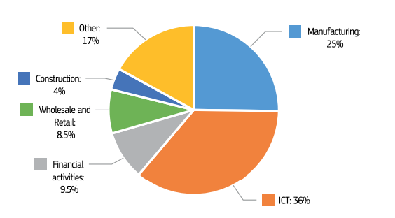
Main targeted sectors in 2021
Notes:
FDI covers a wide range of sectors, but most cases notified concerned manufacturing (44%) – covering a diverse set of industries including defence, aerospace, energy, health and semiconductor equipment, and Information and Communications Technologies (32%).

Slide 10
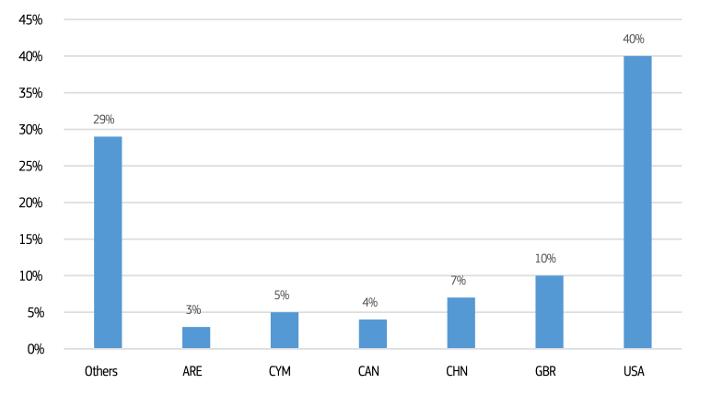
Origin of ultimate investors in 2021
Notes:
The report is giving the EU a much better picture of investment patterns. It shows that the top five countries for the ultimate investor notified in 2021 were the US, the UK, China, the Cayman Islands and Canada. Russian FDI accounted for less than 1.5% of the cases and Belarus for 0.2%

Slide 11
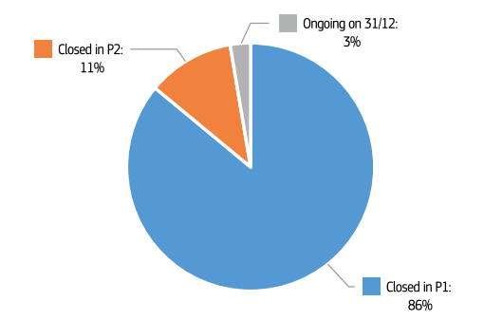
Phase I / Phase II cases

Slide 12
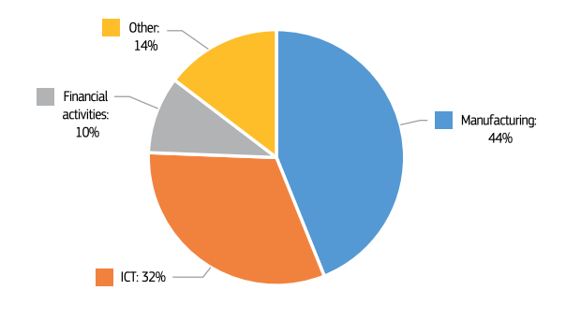
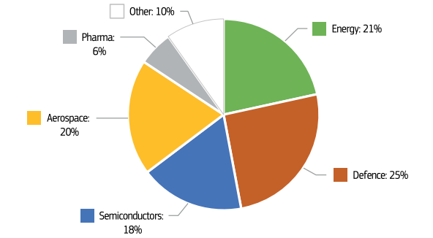
Main sectors in Phase II

Slide 13
Targeted Public Consultation
When – June – July?
47 responses, incl. 18 from MS
Effectiveness, efficiency, relevance, coherence, value added
Backward & forward looking
Call for Evidence – 10 responses
Notes:
Building on the OECD study done at our request which identifies key shortcomings in the current framework, and the results from the ongoing evaluation, DG Trade will be preparing a legislative proposal to revise the current Regulation.
We aim to address three main issues which undermine the effectiveness of the Regulation: i) we miss some critical cases, ii) we see too many non-critical cases, and iii) Member States do not have the power to act on cross-border risks. This is in addition to the fact that Member States are not currently obliged to put national screening mechanisms in place, so gaps remain in the Regulation’s coverage.

Slide 14
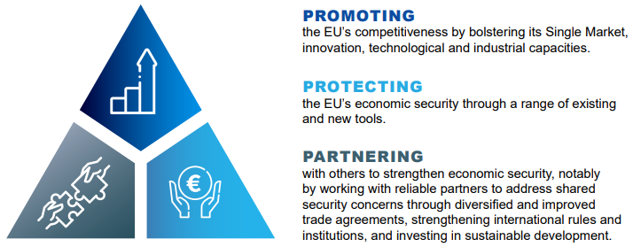
Evolving Policy Context – Economic Security Strategy
Adopted on 20 June 2023
Protecting – Development of trade and security tools
Revision of the FDI Screening Regulation by end 2023
Notes:
Building on the OECD study done at our request which identifies key shortcomings in the current framework, and the results from the ongoing evaluation, DG Trade will be preparing a legislative proposal to revise the current Regulation.
We aim to address three main issues which undermine the effectiveness of the Regulation: i) we miss some critical cases, ii) we see too many non-critical cases, and iii) Member States do not have the power to act on cross-border risks. This is in addition to the fact that Member States are not currently obliged to put national screening mechanisms in place, so gaps remain in the Regulation’s coverage.

Slide 15
Thank you
The content of this presentation does not reflect the official opinion of the European Commission. Responsibility for the information and views expressed in, and during, this presentation lies entirely with the author.

