Slide 1
Protecting dynamic competition in EU merger control
Thomas Deisenhofer, Principal Adviser DG COMP
GCLC, Bruges 17/4/2026

Slide 2
Introduction
General problem
‘Contradiction:
The innovator is motivated by prospect of monopoly rents
But those rents can be used ex post to prevent future innovations and block new entry
Regulating a market economy is largely about how to manage this contradiction ‘
Philippe Aghion
2025 Nobel prize lecture
slides
Panel: dynamic effects of mergers
‘Facebook has systematically tracked potential rivals and acquired companies that it viewed as serious competitive threats.’
FTC revised complaint against Meta (2021)

Slide 3
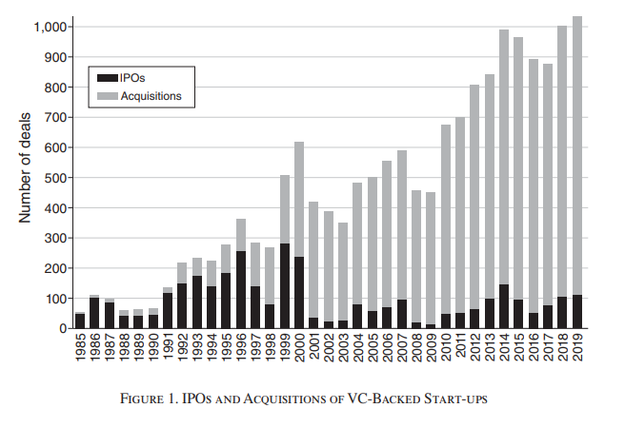
1. Why dynamic effects of M&A require attention
Unprecedented profits at top → motive + means for M&A with dynamic harm | Superstar chapter in DG Comp Report (2024) → winner takes most dynamics Eeckhout (2025) Capital IQ>$5 bn: PR 9%, WPR 21%
Defensive acquisitions are a market reality | 2013 US chartered accountants guidance: purely defensive acquisitions of R&D projects KA in pharma: Cunningham et al (2021), LEAR (2025) Ederer, Pelegrino (2023) FTC study on GAFAM acq (2021).
M&A frequently structured to avoid scrutiny (‘stealth consolidation’) | Wollman (2019, 2022, 2023), Kepler et al.(2024) Cunningham et al (2021) Lear(2025)
Empirical research: harm to innovation efforts + output | Haucap (2019), Ornaghi (2009) (2023) Berger et al. (OECD 2025)
Leading economists concerned about broader effects of M&A on growth + inequality + democracy | Aghion (2025) Tirole (2023) De Loecker, Van Reenen (2022) Kurz (2023, 2026) …
Source: Ederer, Pellegrino (2023)

Slide 4
2. Dynamic effects cases are not easy
Sector specifics matter: pharma ≠ pesticides ≠ platforms ≠ semiconductors ≠ aircraft ≠ …..(J. Sutton (1998))
Defining product markets + innovation spaces: Boundaries + Players
Many possible combinations of mechanisms of harm + parameters of competition
Proving the SIEC = likelihood of harm to effective competition - NB: uncertainty of innovation outcomes or long term pricing harm are often not relevant
Not every defensive merger causes significant harm …
Countervailing dynamic efficiencies
…
Mechanisms of harm
Elimination of potential competitor
Non-coordinated effects
Co-ordinated effects
Foreclosure/entrenchment
…
Harmful effects on …
Prices
Innovation
Quality
Strengthening of dominance
…
…

Slide 5
3. What the Commission does to tackle dynamic harm
Vigilance
above and below thresholds: DMA, pharma etc.
acquisitions in various legal forms including ‘acquihires’
Case-by-case enforcement based on sound law and economics
GE/Alstom
Dow/Dupont + Bayer/Monsanto
Multiple pharma cases
Illumina/Grail
Boeing/Embraer
Booking/ETraveli
Adobe/Figma
…
Ex post evaluation
Pharma study, Entry study, ...
2012-2025
58 interventions based on IToH or ~ 24% out of 245 total interventions
NB: 4613 clearances of which 3702 or ~80% simplified

Slide 6
4. EU Merger control = obstacle to scale-up of EU firms in innovative sectors?
1. Acquisitions by EU acquirers in innovative sectors:
Zero prohibitions/abandonments
Only 12 remedy cases with interventions at the margin
2. For acquisitions by Third Country (TC) acquirers in innovative sectors
4 prohibitions
27 remedy cases with often significant intervention
→ Protecting opportunities of EU firms to compete on global markets
3. For acquisitions by EU acquirers in mature sectors significantly more interventions, but no scale-up, innovation or productivity problems
4. Differences are not driven by discrimination of TC acquirers, but potentially harmful acquisitions by EU acquirers in high tech sectors did not arise: insufficient scale!
→ EU merger control likely not ‘part of problem’, but - if anything - part of the solution

Slide 7
Thank you
Fill in copyright information.
© European Union 2025
Unless otherwise noted the reuse of this presentation is authorised under the CC BY 4.0 license. For any use or reproduction of elements that are not owned by the EU, permission may need to be sought directly from the respective right holders.
Slide xx: element concerned, source: e.g. Fotolia.com; Slide xx: element concerned, source: e.g. iStock.com

