Slide 1
My Presentation
By Lewis Crofts (48 years 5 months)

Slide 2
Slide 2 / 78

Slide 3
The Ugliest Words in the English Language
Moist
Phlegm
Ointment
Crepuscular
Competitiveness

Slide 4
Frequency of Appearance in Works of Shakespeare
Competitor(s) 9 times
Monopoly 1 time
Guide(lines) 28 times
Commission 50 times
Authority 57 times
Europe 10 times
Zero Times
Competitiveness

Slide 5
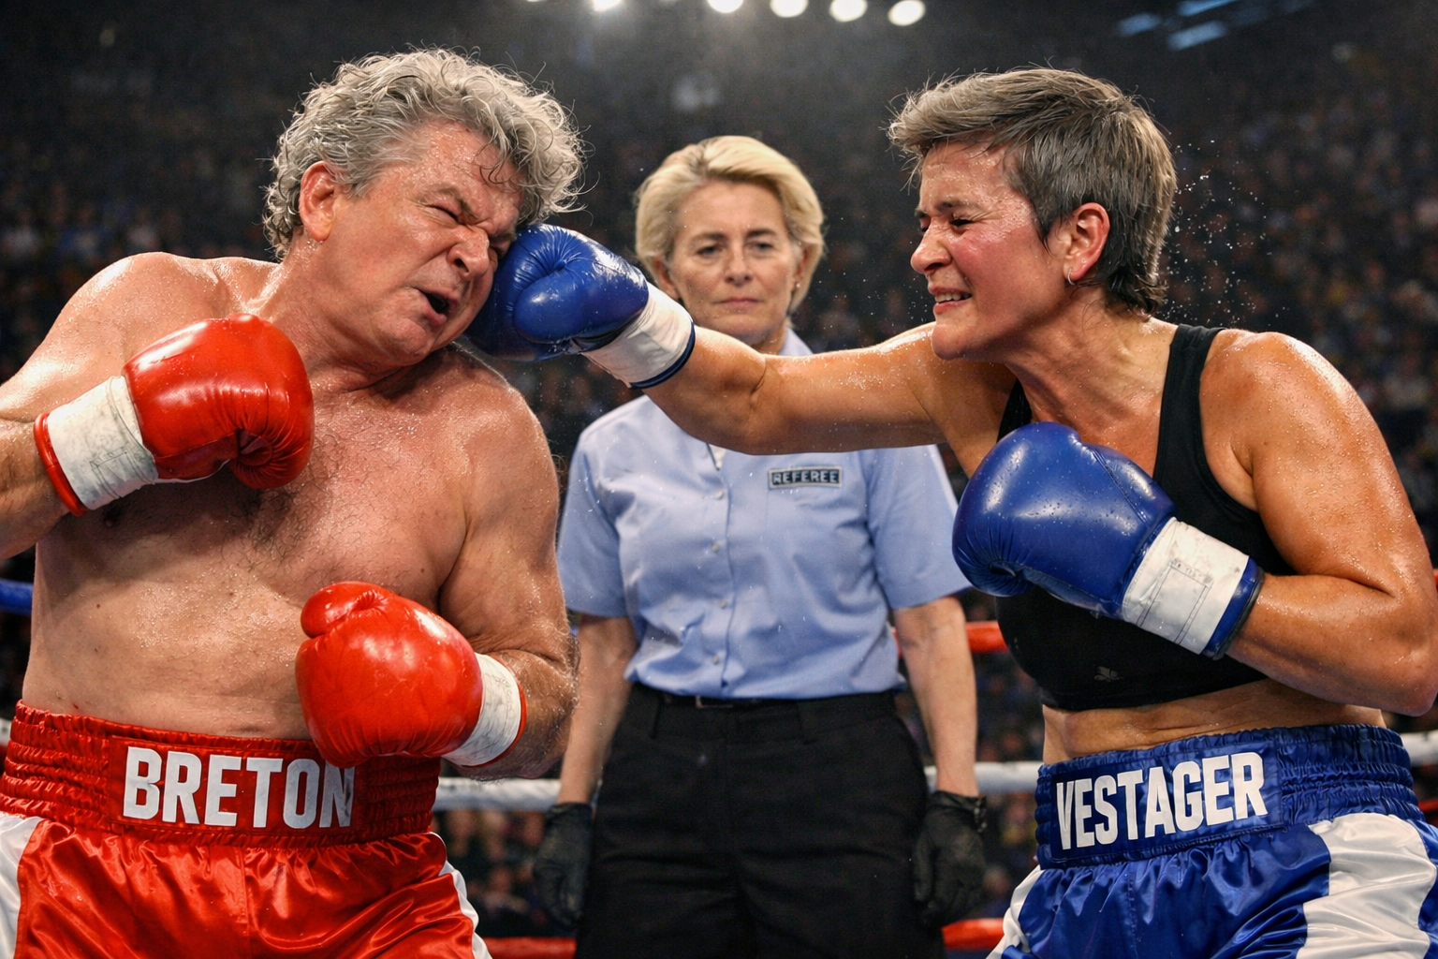
Competitiveness Fight Club

Slide 6
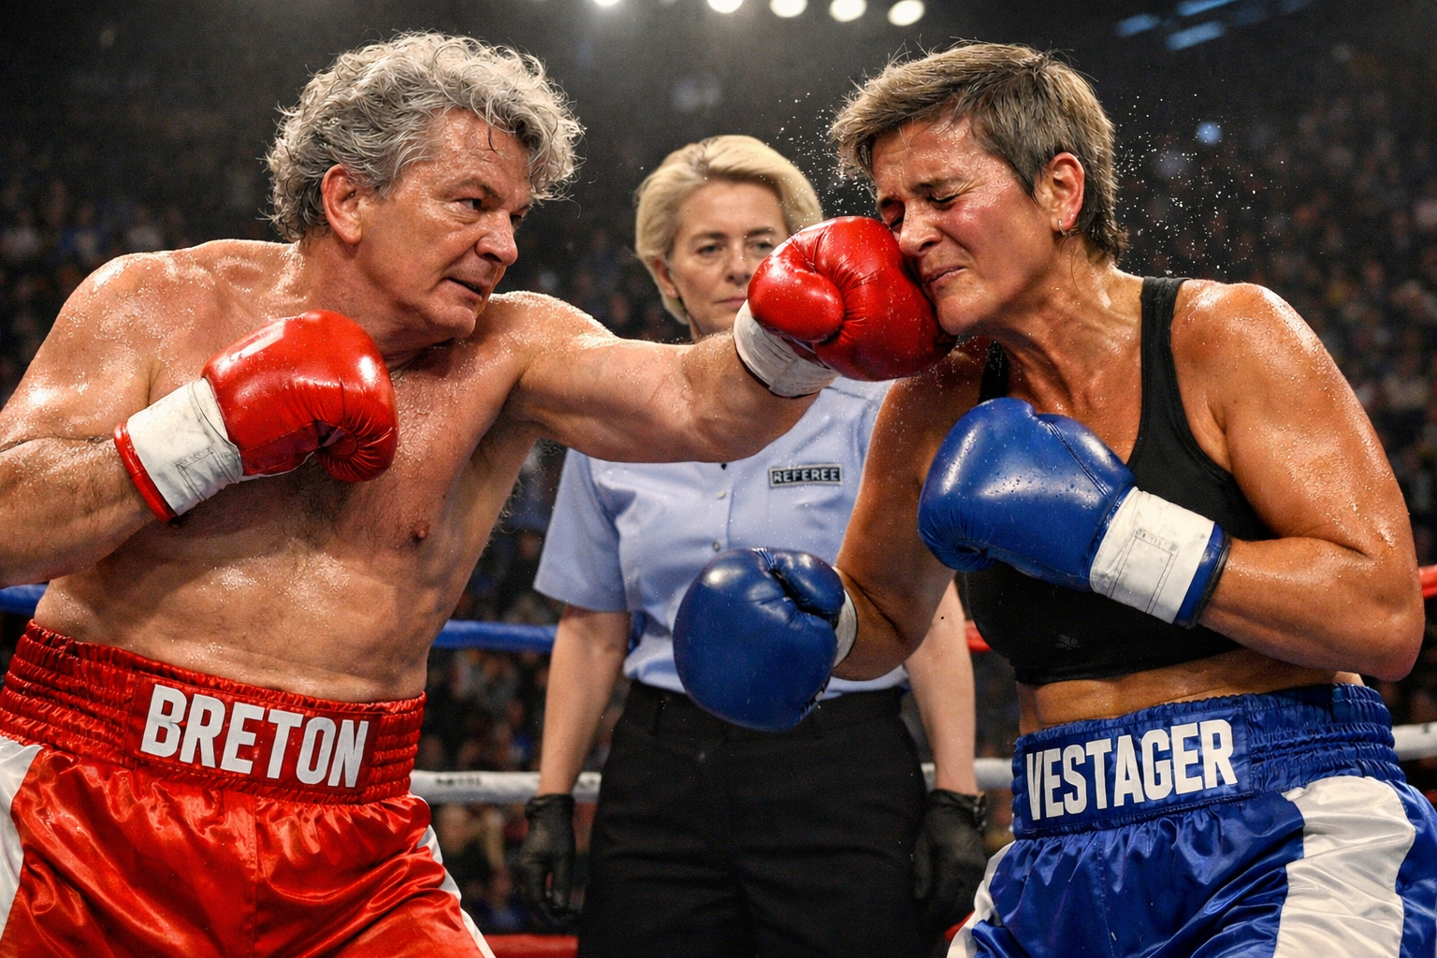
Competitiveness Fight Club

Slide 7
Mission Letter - Von der Leyen to Ribera (Dec. 1, 2024)
Europe needs a new approach to competition policy – one that is more supportive of companies scaling up in global markets, allows European businesses and consumers to reap all the benefits of effective competition and is better geared to our common goals, including decarbonisation and a just transition. Our aim must be to ensure a level playing field, ensure that business has the incentive to invest, innovate and grow, and help protect consumers from rising prices and lowering quality of goods and services. Competition policy should also reflect the growing importance of resilience in the face of geopolitical and other threats to supply chains and of unfair competition through subsidies.

Slide 8
Von der Leyen invitation letter to Summit (March 16):
“The updated guidelines will support mergers that build pro-competitive scale, encourage Single Market integration, and foster pan-European players, while maintaining scrutiny of transactions that could create monopolies or oligopolies to ensure affordability for EU companies and citizens.”
Crofts Competition Policy Industrial Policy Index (CC-PIPI): 7.5

Slide 9
Draft Council Conclusion (1):
“The European Council calls on the Member States and the Commission to improve the conditions throughout the Union for businesses to achieve the scale needed to invest, innovate and compete at global level, in particular in relation to the telecommunications, financial services, space and energy sectors. This would include the ongoing review of the merger guidelines.”
CC-PIPI: 10

Slide 10
Draft Council Conclusion (2):
31.The European Council calls on the Member States and the Commission to improve the conditions throughout the Union for businesses to achieve the scale needed to invest, innovate and compete at global level, in particular in relation to the telecommunications, financial services, space and energy sectors. This would include the ongoing review of the merger guidelines.
32.The European Council calls on the Commission to ensure timely and robust enforcement of the Single Market rules, thus preserving its integrity and a level playing field.
CC-PIPI: 6.5

Slide 11
Draft Council Conclusions (3):
31. The European Council calls on the Member States and the Commission to improve the conditions throughout the Union for businesses to achieve the scale needed to invest, innovate and compete at global level. This includes the ongoing review of the merger guidelines, which should continue to ensure effective competition.
CC-PIPI rating: 6

Slide 12
Slide 12 / 248

Slide 13

Signalling…

Slide 14
EU Parliament draft Report on Competition (Feb. 23)
Calls for a real independent European competition authority under democratic oversight, which is separate from the executive branch to ensure no political interference, and integrates antitrust, merger control, State aid, consumer policy and digital enforcement;

