Slide 2
Library skills
How to find a master thesis

Slide 3
Library skills
You want to have a look at the theses written for your department.
Before you start
A thesis which got less than 15/20 is not at the library
A thesis is only available digital
Last year theses are available from mid-October onwards

Slide 4
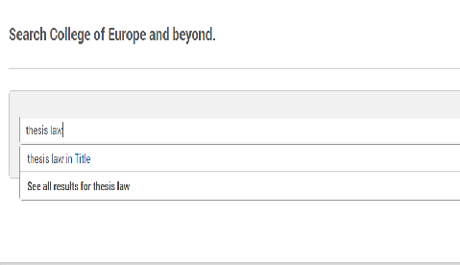
Library skills
You can search for a thesis for your department
Your search string is the following
thesis law
thesis economics
thesis politics
thesis international relations and diplomacy

Slide 5
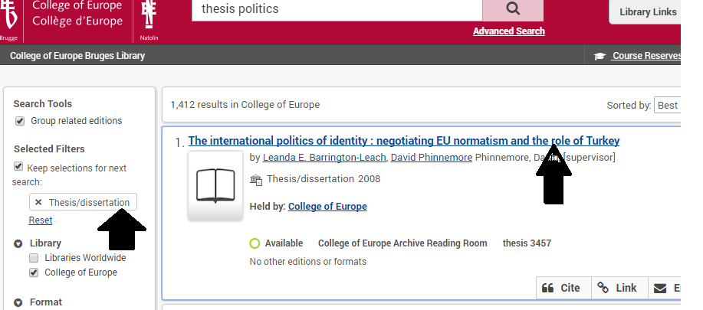
Library skills
You can narrow your research further by adding your supervisor’s last name, year of publication, you can put your search string in the search box
You also can use the menu on the left side of the screen

Slide 6
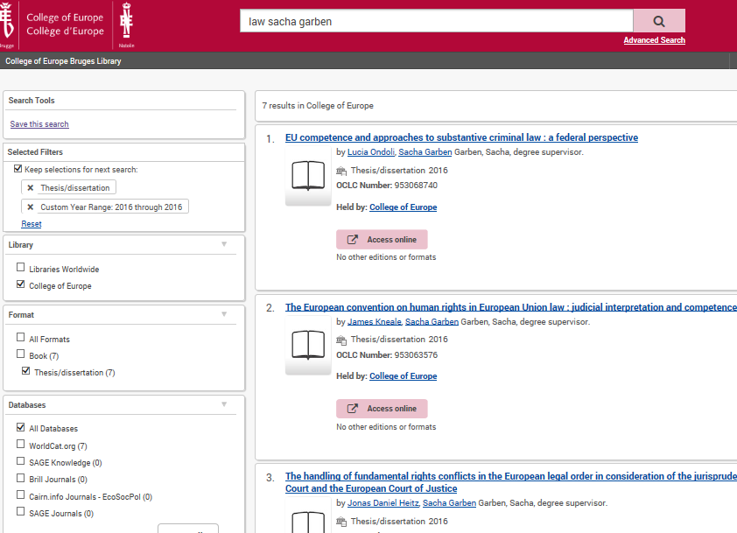
Library skills
Use the filter
“thesis/dissertation” on the left menu bar.
2. When you press enter,
your specifications will be saved on top in the ‘selected filters’.
2.
1.

Slide 7
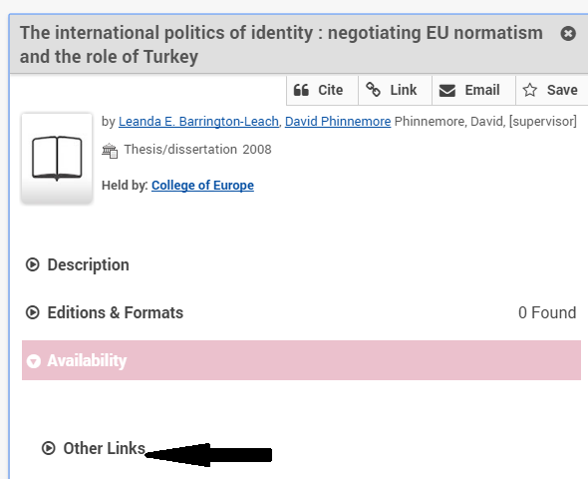
Library skills
Click on the detailed title - the following screen will appear
Click on “other links”

Slide 8
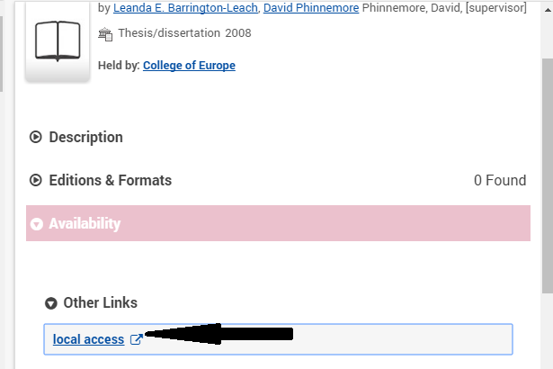
Library skills
2. Click on “local access”
3. On the bottom of the screen you’ll find the pdf file →

Slide 9
Library skills
Thank you for following this presentation.
If you have any questions or suggestions for other presentations to facilitate your library experience :
Feel free to contact me :
renee.maeyaert@coleurope.eu

