Slide 2
library skills
Search the catalogue

Slide 3
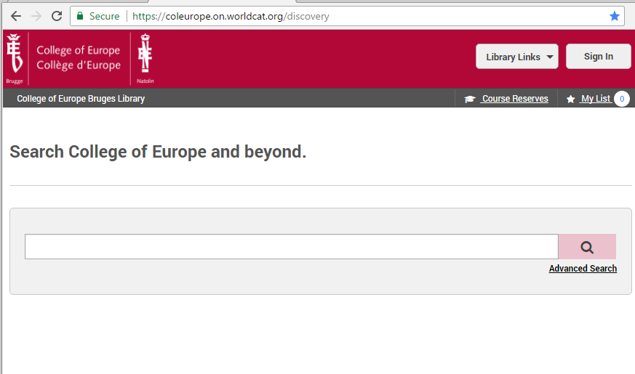
LIBRARY SKILLS
Click on the link https://coleurope.on.worldcat.org/discovery
This screen will appear
Click on sign in, and log in with your email address and your college password. If you have some difficulties have a look at the powerpoint presentation “Setting up your library account”. If you still cannot sign in, contact our services,
PS : If you are not at the college, nor in the residences, click on Library links – remote access login

Slide 4
LIBRARY SKILLS
Or go to our intranet page https://www.coleurope.eu/groups/bruges-library-group
Click on one of the icons, to specify what type of document you want to find
Then type in the name of the author, subject or title …
Click on the magnifying glass

Slide 5
LIBRARY SKILLS
Simple search
2. Advanced search
3. Library links
4. Course reserves
5. My list

Slide 6
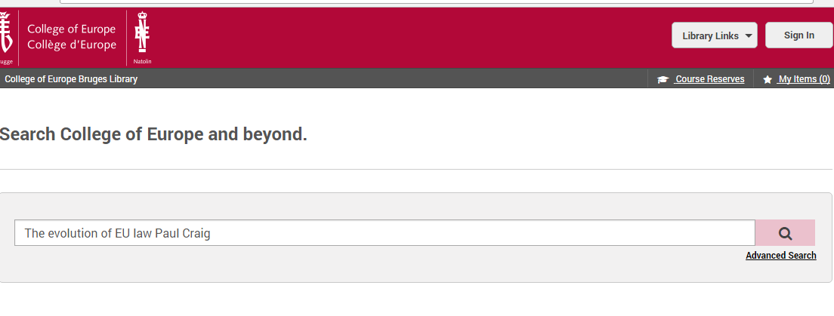
Library skills - simple search
Type the title and/or author in the search screen

Slide 7
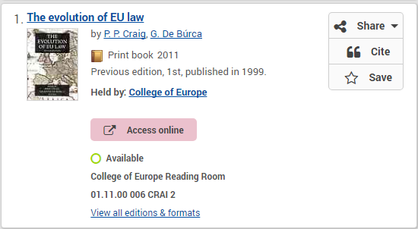
Library skills - simple search
What can you find out about this book ?
If the book is available ?
Held by our library ?
Where you can find it in the library ?
Is the full text available ?
2.
4.
Access online
does not always mean that we have the ebook, in this case it gives you access to the table of contents
To find other editions and formats click on ”all editions & formats’.
1
3

Slide 8
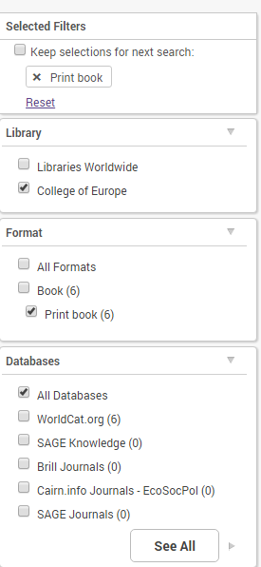
Library skills - ADVANCED search
To refine your search and change the default sort
check the filters on the left of your screen

Slide 9
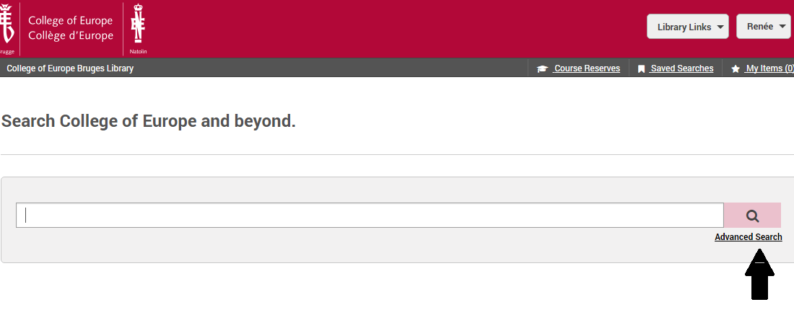
Library skills - ADVANCED search

Slide 10
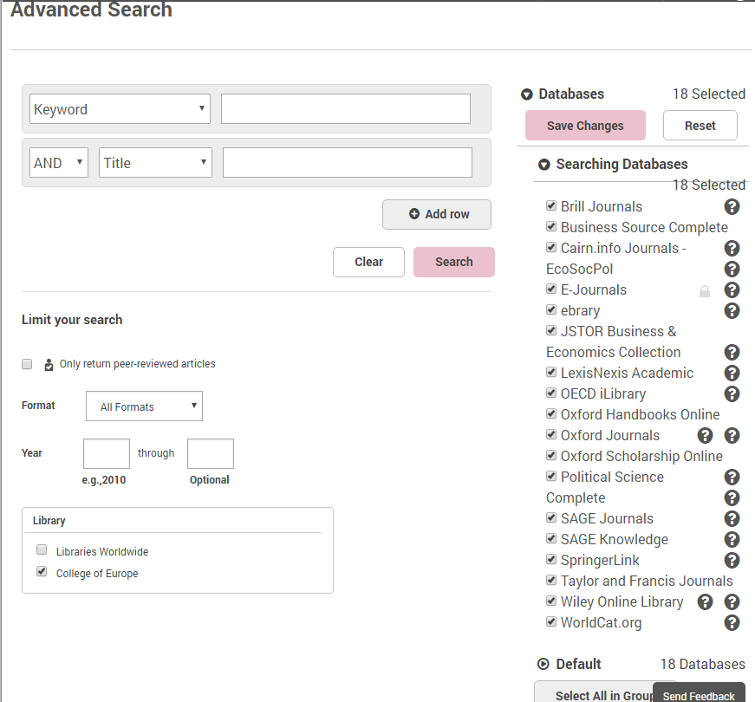
Library skills - ADVANCED search
Or detailed research
Add several keywords, authors etc.
Add rows to speficy your research more.
Look for a specific format (book, article)
Specify your source (check the database)
Broader : look in libraries worldwide if we do not have any materials on your topic, and post a request for an Interlibrary loan. https://www.coleurope.eu/groups/bruges-library-group/intranetpage/request-book-or-journal-article
1
$$2$$
3
4
5

Slide 11
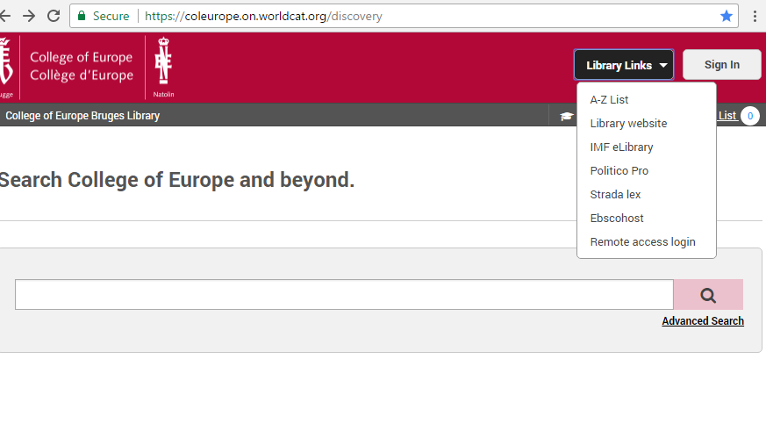
Library skills – library links
Link to our website
A-Z list = e-resources
Extra sources, databases
Remote access login
(= off-campus access)

Slide 12
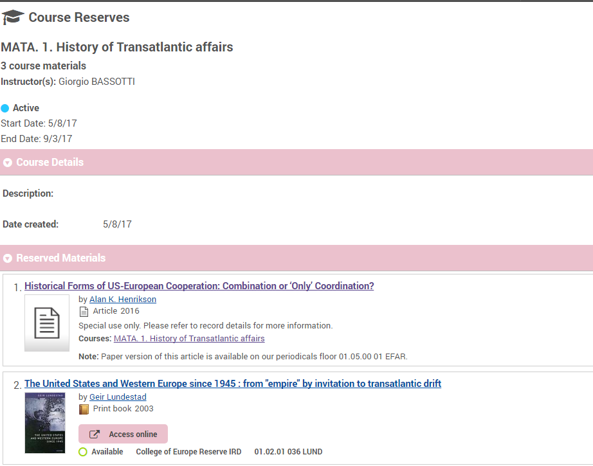
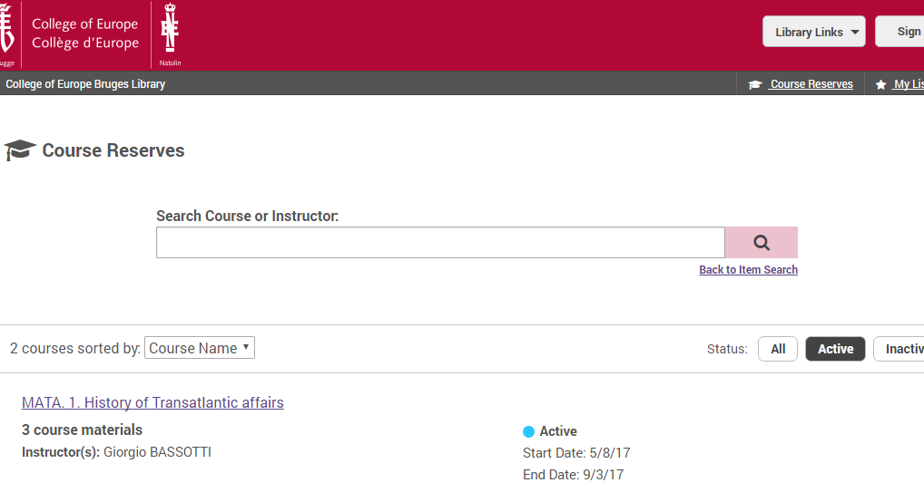
Library skills – COURSE RESERVES
Course readings : recommended books or articles for your courses - click on “course reserves”
- click on your course
Articles : click on the title
Books : you’ll find the shelfmark

Slide 13
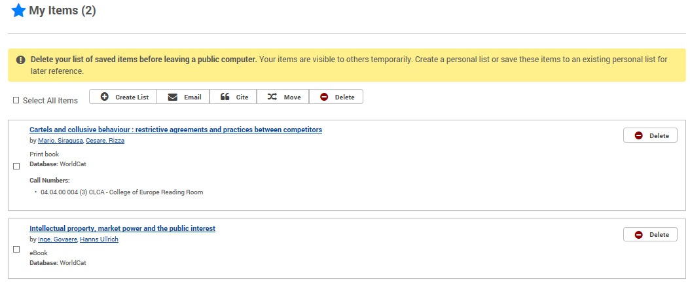
Library skills – MY LIST
If you want to create a booklist, click on the star Save, it will turn blue and it will say saved
On top of your screen you will see My items (,,) , click on it and you see your list of saved items.
You can email your list of saved items, to yourself (you will receive a library message from do-not-reply@oclc.org with the item you saved.

Slide 14
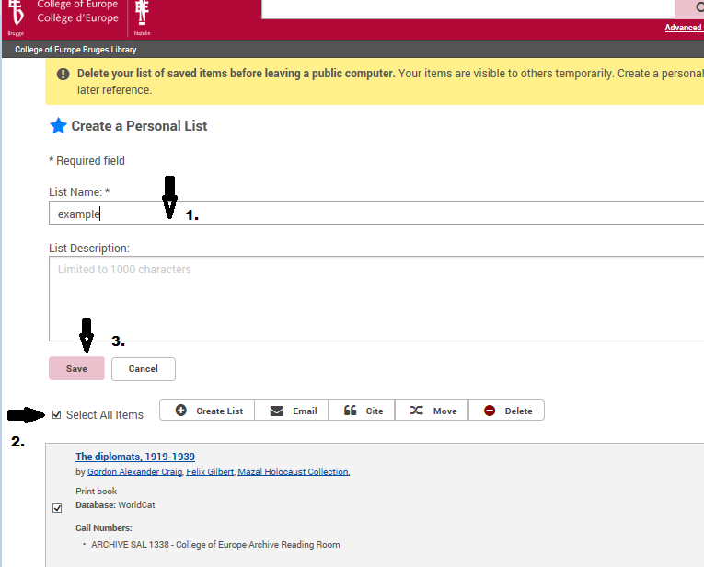
Library skills – MY LIST
If you want to keep your book list after your library session, create your personal list.
Give your list a name
Select one or all of the items you want in the list
Click on save

Slide 15
Library skills – library links
Thank you for following this presentation.
If you have any questions or suggestions for other presentations to facilitate your library experience :
Feel free to contact me :
renee.maeyaert@coleurope.eu

