Slide 2
Library skills
Creating a library account

Slide 3
Library skills
On intranet
https://www.coleurope.eu/groups/bruges-library-group
On internet
https://www.coleurope.eu
In the menu
click on library
click on the magnifying glass

Slide 4
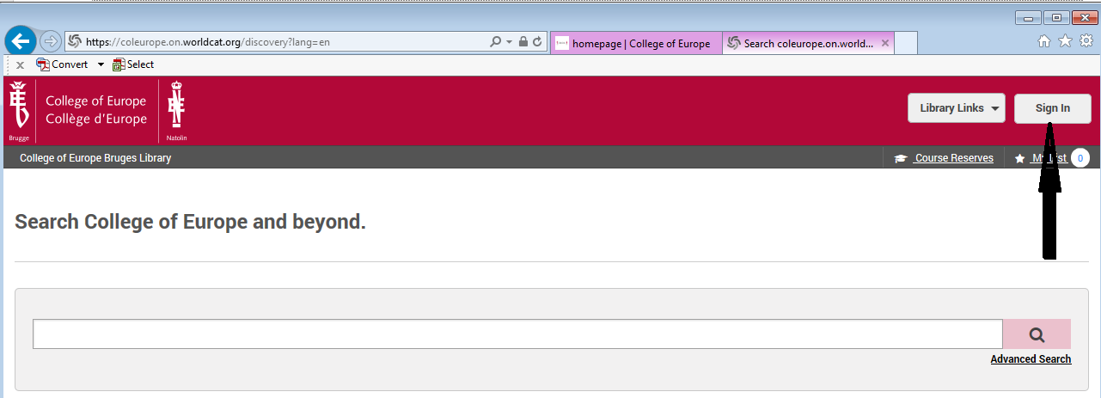
Library skills
Click on sign in*
*Before you can borrow library items, you need to ‘sign in’

Slide 5
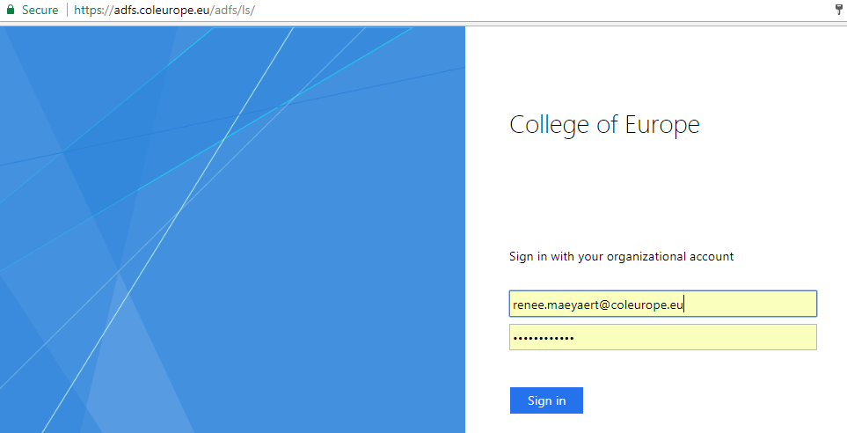
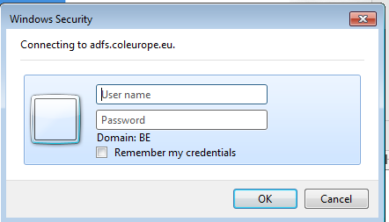
Library skills
Fill in your College email address and password
← chrome
Internet explorer →

Slide 6
Library skills
What can you do with your library account?
Check the due date of your loans
Renew the loan period of your borrowed items
Check your holds
Check your fines

Slide 7
Library skills
Thank you for following this presentation.
If you have any questions or suggestions for other presentations to facilitate your library experience :
Feel free to contact me : renee.maeyaert@coleurope.eu

