Slide 1
Which market design for Europe?
The role of capacity mechanisms
King’s College London, College of Europe conference
Capacity mechanisms in Europe – The fundamental issues behind the ongoing sector inquiry
Fabien Roques, Senior Vice President, Compass Lexecon
Brussels – 28 September 2015

Slide 2


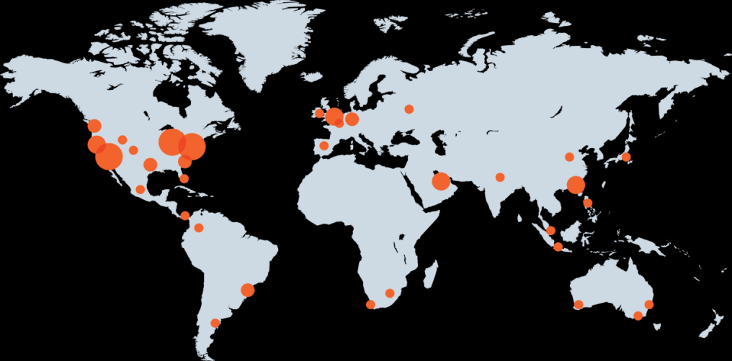
About FTI
FTI Consulting at a Glance
FTI Consulting is a global business advisory firm that provides multidisciplinary solutions to complex challenges and opportunities
GLOBAL REACH
With 4,200+ professionals and offices in 24 countries on six continents, our breadth and depth extends across every major social, political, and economic hub across the globe
FTI CONSULTING FAST FACTS
1,300+
clients served
3 Nobel
Laureates
2012 Award for Business Strategy
FTI Consulting was recognized for helping The E.W. Scripps Company reinvent its newspaper operating model
700+
Industry experts
1982
EXPERIENCED PROFESSIONALS
We are trusted advisors with diverse expertise and exceptional credentials serving clients globally
Year founded
$2bn
enterprise value
FCN
publicly
traded - NYSE
DEEP EXPERTISE
We combine unparalleled expertise and industry knowledge to address critical challenges, in both event-driven and long-term scenarios

Slide 3



About FTI
Service span of FTI Consulting –Energy Services
FTI Consulting operates across 5 service lines
Corporate
Finance
Forensic and
Litigation Consulting
Economic and Financial Consulting
Strategic Communications
Technology
Provide strategic, operational, financial and capital needs of businesses. Address complete spectrum of financial and transactional challenges.
Independent dispute advisory, investigative, data acquisition/analysis and forensic accounting services.
Analysis of complex economic, regulatory and finance issues to assist clients in understanding the issues and opportunities they face.
One of the world’s largest investor relations businesses specialising in advising companies in critical situations.
Provides e-discovery software, services and expertise to deliver smart solutions for clients.
We support clients across the energy value chain
Strategic Evaluation
Project / Company Development Support
Operational Enhancement
Market Entry/Exit Strategy Policy Evaluation Resource, Technology & Market Assessment Supply chain evaluation / development Asset Valuation Business Model Evaluation / Development M&A / Transaction Support | Due Diligence (technical / financial) (with TÜV SÜD PMSS) Project Finance and Transaction Support Dispute Resolution Independent Engineer Review (with TÜV SÜD PMSS) PPA Negotiations Resource evaluation T&D Analysis | O&M strategy Business Planning , root cause analysis, and performance improvement Procurement & Contracting Best Practices Turnaround and Restructuring Liquidity management Interim management (CRO, COO, CEO, CFO) Insolvency

Slide 4
Agenda
What are the drivers of capacity mechanisms?
Energy only or capacity mechanism?
Debunking myths about capacity mechanisms
How to ensure cross border participation in capacity mechanisms?
Conclusions

Slide 5
Drivers of capacity mechanisms

Slide 6

Drivers of capacity mechanisms
The good, the bad, and the ugly…
Economic drivers
Drivers of implementation of capacity mechanisms
Drivers of reform depend on many country specific factors
  Existing generation mix and embedded flexibility
  Market arrangements
  Level of interconnection
Looking forward, member states have different needs
  Some countries need more dependable capacity, others need flexibility to support renewables, others are well supplied by all measures…
Guarantee politically determined security of supply criteria
Address market failures affecting security of supply (missing money)
Support timely investment
Rescue stranded thermal plants
Smooth power prices to reduce “politically unsustainable” volatility
Dampen investment and retirement cycles
Political drivers

Slide 7
Drivers of capacity mechanisms
How much harmonization is necessary ?
  A wide range of market arrangements across Europe…
Model 1: Ireland
No meaningful forward market
Central dispatch with complex bids\offers
Traded volumes/prices not firm
Locational bidding
D-1 gate closure
No intraday market
Fixed capacity payment
Model 2: ES, PT, IT
Financial forward market
Quasi-mandatory day-ahead auction
Locational bidding
Intraday auction slots
H-4 gate closure or more
Capacity and availability payment
Model 3: Nordic, CWE
Financial and physical forward markets
DA auction with strong market support
Portfolio bidding
Continuous trading
H-1 gate closure (or less being considered)
Strategic reserve (Nordics, Be, De)
Decentralized forward capacity market (Fr)
Model 4: GB
Mainly physical forward market
No particular significance of DA
Portfolio bidding
Continuous trading
H-1 gate closure
Centralized forward capacity market
Forward
Market
Day
Ahead
Intraday
Capacity
  … which suggests harmonization of CM will be as challenging

Slide 8
Drivers of capacity mechanisms
Member states have different issues and needs…
 | FRANCE | GERMANY | UK | SPAIN | ITALY
Local specificities | - Thermo sensitivity of power demand (electric heating) - Peak demand growth | - Grid constraints from North to South - Nuclear phase-out - Strong RES growth | - Large retirements of thermal plants - Limited interconnection - Strong RES growth | - Weak demand - Strong RES growth - Limited interconnection - Quasi-mandatory pool | - Internal zones and grid constraints - Strong RES growth - Central dispatch
Key issues | - Peak demand growth (+25% in 10 years) - Missing money for peak plants - Low profitability of CCGTs | - Capacity needs in Southern Germany - Flexibility needs - Low profitability of CCGTs | - Major investment needs (capacity gap) - Retirements driven by Large Combustion Plant Directive and Industrial Emissions Directive - Need for flexibility | - Overcapacity and low profitability of CCGTs - Generation back-up necessary due to RES penetration | - Overcapacity and low profitability of CCGTs - Coordination of generation and network investment - Flexibility needs
Main objectives of capacity mechanisms | - Ensure generation adequacy - Support the development of demand response - Prevent market power abuses | - Retain existing capacity in the Southern Germany & drive new investment - Ensure availability of flexible back-up generation | - Ensure generation adequacy - Drive new investment in CCGTs - Ensure availability of flexible back-up generation | - Incentivise availability and flexibility of existing plants - Manage smooth rebalancing / avoid massive retirements - Limit price spikes & volatility | - Incentivise availability and flexibility of existing plants - Manage smooth rebalancing / avoid massive retirements - Prevent market power abuses
  => This suggests that a ‘one-size-fits-all’ approach is unlikely to work

Slide 9
Energy only or capacity mechanism?

Slide 10
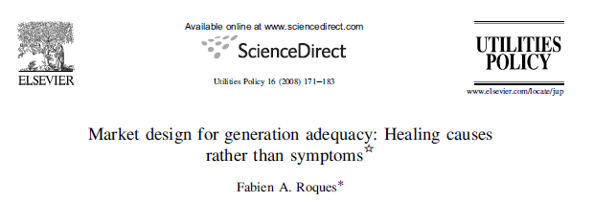
Energy only or capacity mechanisms?
Scarcity pricing is key…
“Electricity market reform and particularly the need for complementary mechanisms to remunerate capacity need to be analysed in the light of the local regulatory and institutional environment.
If there is a lack of investment, the priority should be to identify the roots of the problem.
The lack of demand-side response, short-term reliability management procedures and non-market ancillary services provision often undermine market reflective scarcity pricing and distort long-term investment incentives”

Slide 11
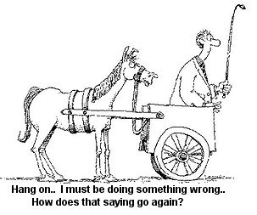
Energy only or capacity mechanisms?
…But risk hedging mechanisms are necessary
The old saying goes “Don’t put the cart before the horse”
Can all parties (including renewables operators) exposed to market price risks hedge their risk exposure?
Scarcity pricing needs to be supplemented by hedging products / fixed cost recovery mechanisms
  There are - rare – cases of voluntary long term hedging mechanisms (CFDs, reliability options in Australia)
  In case of missing market / product for hedging, consider legal obligations on suppliers or centralized procurement of forward capacity / hedging products

Slide 12
Energy only or capacity mechanisms?
Conclusion: scarcity pricing and capacity mechanisms are complimentary
Capacity mechanism / risk hedging scheme
Reforms of energy markets to remunerate flexibility
Integration of renewables
Sound remuneration of flexible / dependable plants and DSM
Volatile energy prices
Support for recovery of fixed costs
Liquid markets to hedge risks
Remuneration of operational flexibility

Slide 13
Debunking myths about capacity mechanisms

Slide 14
Debunking myths
4 misconceptions about capacity mechanisms
There is a choice between two opposite directions : scarcity pricing or capacity mechanisms
Capacity mechanisms are subsidies to stranded assets
A capacity mechanism will remove price spikes necessary to stimulate efficient system response
Capacity mechanisms defined nationally are distorting EU energy markets
These incorrect common beliefs derive from:
  Biased comparison of a perfect theoretical energy only market with an imperfect capacity mechanism
  Misunderstanding of the interface between energy market and capacity mechanisms
1
2
3
4

Slide 15
Debunking myths
How do energy and capacity markets interface?
What are the concrete interactions between energy and capacity mechanism?
  Short term dispatch effects
    No effect on spot market unless capacity product is linked to physical injection (none if product based on availability), and even in this case limited to crisis situations
    Second order effects associated with changes in maintenance schedules, etc.
    No impact on cross border flows unless specific curtailment / redispatch rules are implemented
  Long term mix effects
    Different generation mix (changes in plant retirements / investment decisions): overcapacity only if target capacity not aligned with reliability criteria determined by policy makers
    Design parameters (technology neutrality, market based, etc.) critical to drive potential deviations from optimal mix (peak versus base load, supply versus demand, etc.)
Are the potential effects of these interactions significant?
  Short term dispatch effects
    Likely insignificant, and smaller than distortions induced by uncoordinated RES policies, national generation mix interventions (support to local fuels, nuclear phase out), ETS exemptions and carbon price floor, etc.
  Long term mix effects
    Potentially significant, but no more than RES policies / national generation mix interventions, etc.
How can the potential distortions be minimised?
    Sound design (product definition based on availibility, design parameters, etc.)

Slide 16
How to ensure cross border participation in capacity mechanisms?

Slide 17
Cross-border participation in capacity mechanisms
The different methods
1
2
3
4
5
No Contribution
Statistical contribution
Interconnector participation
Foreign Capacity participation
Cross-border Capacity Mechanism
Neither interconnectors nor foreign providers contribute
Contribution evaluated statistically and deducted from capacity target
Interconnector participates directly in capacity mechanism
Foreign capacity providers participate directly in capacity mechanism
Capacity mechanisms cover several zones OR national capacity mechanisms are “coupled”
This applies to most countries with capacity payment mechanisms (price based)
Initial GB (net 0 contribution) and French approaches (~7GW out of 9GW of import capacity)
Solution implemented in GB from 2015 onwards, work in progress in Fnrance
This has been implemented in the PJM Capacity Market
No current international examples (except zones in PJM and Italy)
The definition of capacity products is a key – particularly whether the obligation is based on energy delivery or availability

Slide 18
Cross-border participation in capacity mechanisms
Need for a framework to deal with situations of coincidental scarcity
2a
Energy market: scarcity situation simultaneously in A & B
A
Price cap
Price cap
B
1
Capacity procurement
Price: 3k€/MWh
Demand: 51GW -Supply: 49GW
Price: 3k€/MWh
Demand: 54GW-Supply:48GW
A
CRM
B
49GW
LOLE 3H => 51 GW
0GW
49GW
2GW
2b
Energy market: scarcity situation simultaneously in A & B
2GW
A
No price cap
No price cap
B
Price: 20k€/MWh
Demand: 51GW -Supply: 49GW
Price: 24k€/MWh
Demand: 54GW-Supply:48GW
49GW
2GW
In this example, country A contracted capacity up to 51GW, but only 47-49GW of its demand is satisfied depending on the situation
Without specific rules to control on capacity contracted abroad at times of scarcity, cross border participation has no value added in terms of security of supply over a simple statistical approach

Slide 19
Conclusions

Slide 20
Conclusions
Current European electricity markets are incomplete and do not send the right price signals:
  Reforms of energy markets to reward flexibility and capacity mechanisms (CMs) are both needed and complementary
  Drivers for implementation of CMs differ across member states and explain patchwork of approaches
  One-size-fits-all approach unlikely to work and not necessary
Interaction of CM and energy market are misunderstood and largely overplayed:
  Well designed CM will not reduce price spikes, or affect cross border flows significantly
  Magnitude of potential distortions is small compared to distortions associated with other public interventions (RES support, etc.)
Cross border participation in CMs raises complex issues:
  Several approaches possible for explicit foreign participation with pros and cons
  Need for a European framework to deal with situations of coincidental scarcity
Capacity mechanisms are only a stepping stone - long term market design challenges:
  TM historically focussed on short term operational issues, focus needs to turn to investment incentives
  Risk hedging/sharing mechanisms such as long term contracts to reduce financing costs and support investment
  Coordination mechanisms for transmission, merchant generation and policy driven clean technologies

Slide 21
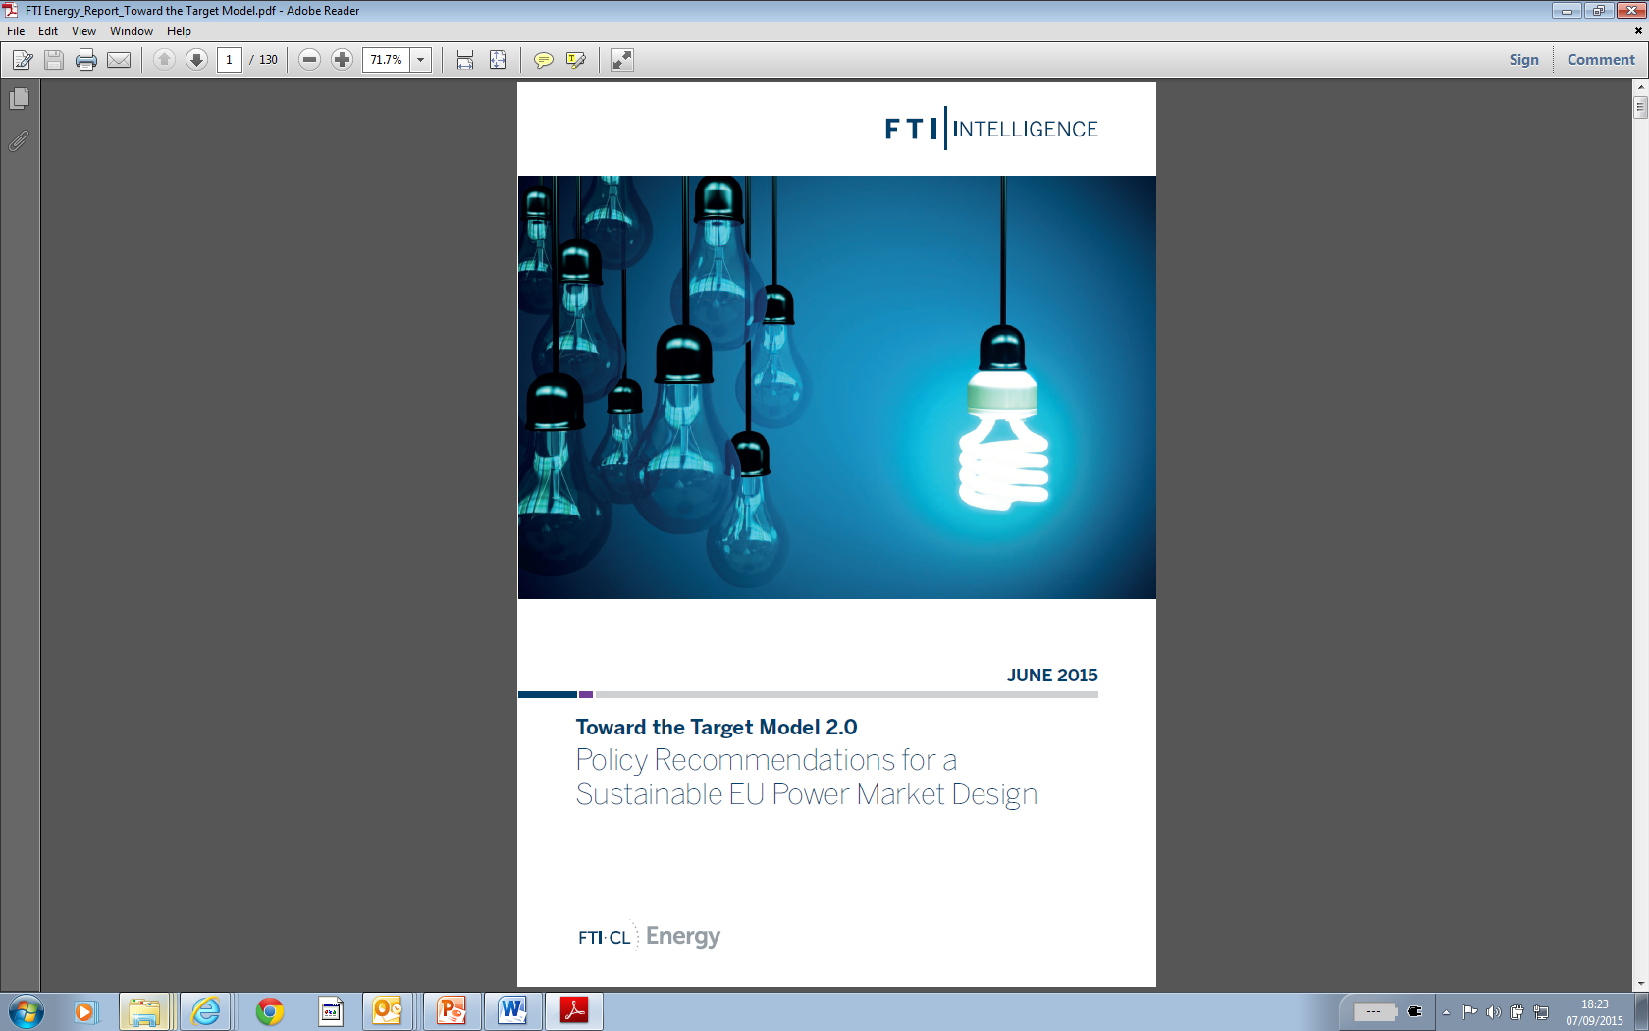
References
Toward the Target Model 2.0 –
Policy Recommendations for a sustainable market design
Web link
Publications on capacity mechanisms
Market design for generation adequacy: healing causes rather than symptoms Web link
Coordinating capacity mechanisms – which way forward? Web link
European electricity market reforms: the “visible hand” of public coordination Web link
Publications on European electricity markets
The new European Energy Union - Toward a consistent EU energy and climate policy? Web link
European electricity markets in crisis: diagnostic and way forward Web link

Slide 22

Thank you for your attention
Fabien Roques
Senior Vice President
FTI - COMPASS LEXECON
froques@compasslexecon.com
Fabien Roques
Associate Professor
Université Paris Dauphine
fabien.roques@dauphine.fr
DISCLAIMER
The authors and the publisher of this work have checked with sources believed to be reliable in their efforts to provide information that is complete and generally in accord with the standards accepted at the time of publication. However, neither the authors nor the publisher nor any other party who has been involved in the preparation or publication of this work warrants that the information contained herein is in every respect accurate or complete, and they are not responsible for any errors or omissions or for the results obtained from use of such information. The authors and the publisher expressly disclaim any express or implied warranty, including any implied warranty of merchantability or fitness for a specific purpose, or that the use of the information contained in this work is free from intellectual property infringement. This work and all information are supplied "AS IS." Readers are encouraged to confirm the information contained herein with other sources. The information provided herein is not intended to replace professional advice. The authors and the publisher make no representations or warranties with respect to any action or failure to act by any person following the information offered or provided within or through this work. The authors and the publisher will not be liable for any direct, indirect, consequential, special, exemplary, or other damages arising therefrom. Statements or opinions expressed in the work are those of their respective authors only. The views expressed on this work do not necessarily represent the views of the publisher, its management or employees, and the publisher is not responsible for, and disclaims any and all liability for the content of statements written by authors of this work.

