Slide 1

Capacity mechanisms in Europe
The fundamental issues behind the ongoing sector enquiry
Session 2 - If a capacity mechanism, which design is most appropriate?
Andrea Villa – Enel S.p.A.
Brussels,
28th September 2015

Slide 2
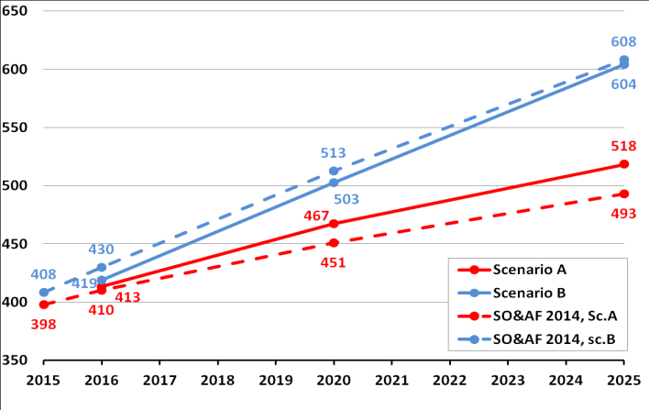
Future RES Development
Renewable share on final gross consumption*
RES Generation Capacity**
GW
RES investments still needed to achieve 2030 targets
(*) RES target refers to all sectors (electricity, heating and cooling, transport) Sources: Primes 2013, 2030 Climate Energy Package
(**) ENTSO-E Scenario Outlook & Adequacy Forecast 2015, page 27

Slide 3
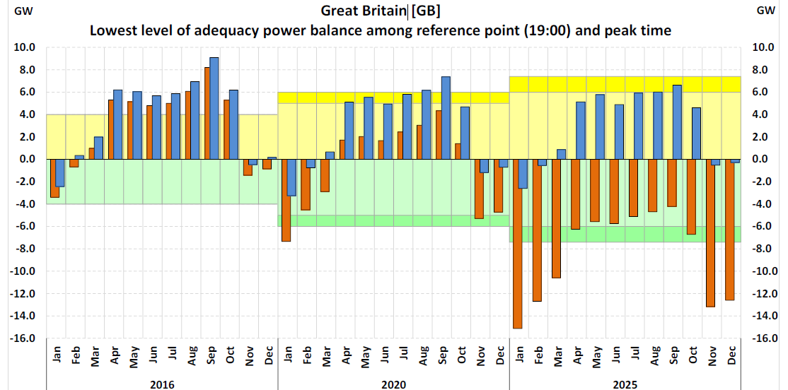
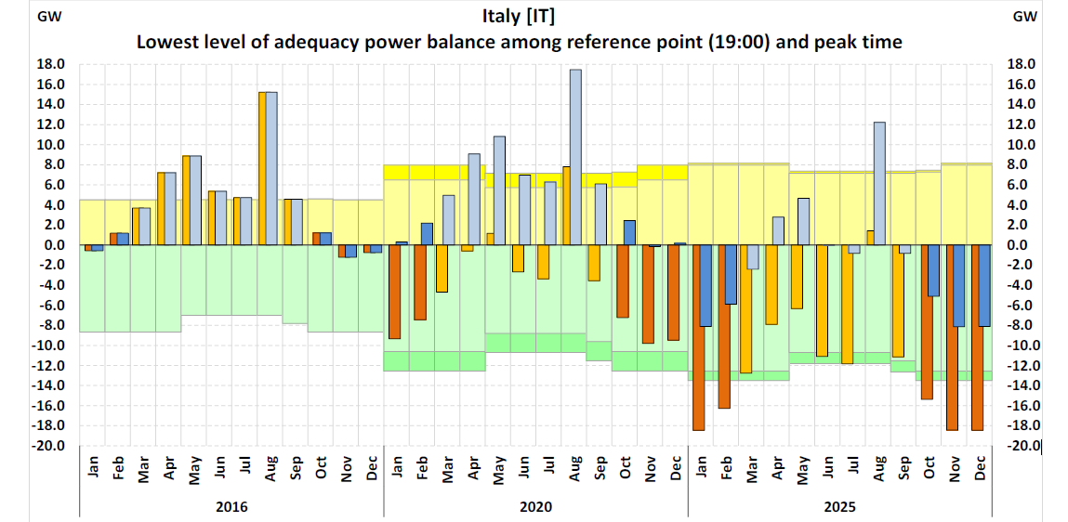
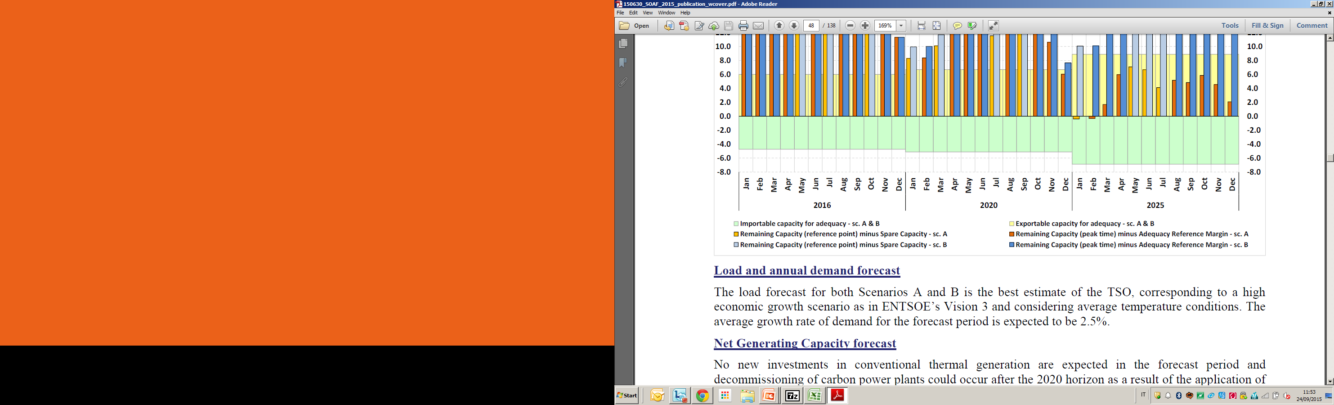
Adequacy Forecast
2016 - 2025
New capacity needed
Source: ENTSO-E Scenario Outlook & Adequacy Forecast 2015, pages 50 and 58

Slide 4
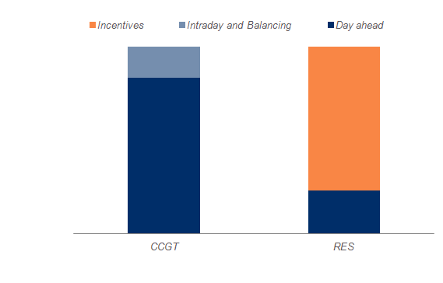
Future Trends in European Electricity Markets
  Now
  Near future
  Next Decade
  RES still not dominant in the energy mix
  Energy prices >0 most of the time
  RES offer limited balancing services
  Predictable imbalance costs
  RES more prominent in the energy mix
  Energy prices >0 most of the time, but many hours with 0 and <0 prices
  RES offer some balancing services
  Imbalance costs increases
  Bulk of energy from RES
  Energy prices 0 and <0 for many hours
  RES offer balancing services
  Imbalance costs very high
  Shares of Revenues
  Variability in energy prices increases financing costs for new projects
  Low revenues for programmable capacity could bring problems of Security of Supply
Note: Graphs are illustrative

Slide 5



Current Debate
Examples
Focus on energy-only market : how to foster day-ahead, intraday, and balancing prices
Capacity mechanism based on capacity tickets
The two sides have started tackling some issues of the current market design BUT they miss the major point: how to foster long-term signals

Slide 6
Capacity Remuneration Mechanisms (CRMs)
CRMs
Price-based
Volume-based
Capacity Payment
Strategic Reserve
Capacity Tickets
Capacity Auctions
Reliability Options
  Ability to provide long-term signals

Slide 7
Introduction of Reliability Options in Italy
Today
Legislative Decree 379/2003
Introduction of interim Capacity Payment
NRA to define an adequate competitive Capacity Remuneration Mechanism
Directive 2009/28/EC
2010
Two NRA Consultations on details on parameters of Reliability Options
NRA Decision 375/2013
Final NRA approval
1/7/2014
Entry into force
Guidelines on State aid for environmental protection and energy
2008
First Consultation on possible models of CRMs
2009
Second NRA Consultation on CRMs
NRA Decision 98/2011
Regulators defined criteria to be followed by TSO’s proposal
30/06/2014
Ministerial approval
First Auction

Slide 8
Reliability Options in Italy
1-way CfD between TSO and selected counter-parties
Selected counter-party
Central buyer
(TSO)
Spot Price – strike price (if>0)
Premium
Rights
Receive premium (€/MW/year) during delivery period
Obligations
To submit offers in DAM and Ancillary Service Market (ASM)
To pay the difference between spot price and strike price (if>0)
Deliver long-term signals for all capacity
Incentives to deliver capacity when is needed
Market-defined triggers and penalties
Benefits

Slide 9
Auctions for Reliability Auctions in Italy
Auction year
Delivery period
General Auction
Lead time 4 years
Adjustment Auctions
Lead time 3, 2, 1 year
Delivery period 1 year
Delivery period 3 years
Secondary Market
Lead time <1 year
Delivery period 1 month

Slide 10
Reliability Options
Supply and Demand
Supply
Voluntary participation of not incentivised new and existing national programmable capacity > 10 MVA (de-rated capacity, calculated by TSO)
Possible participation of foreign capacity, distributed generation and demand side management in future auctions
Zonal Demands
Negative sloped zonal demands defined by TSO considering VOLL, electricity demand and required reserve (netting for foreign interconnection capacity)
P
Q
Note: Graph is illustrative. For existing capacity under discussion the possibility to receive a minimum premium equal to avoidable fixed costs
Calculation of de-rated capacity considers average unavailability due to incidents and technical and regulatory imitations
VOLL: Value of Lost Load

Slide 11
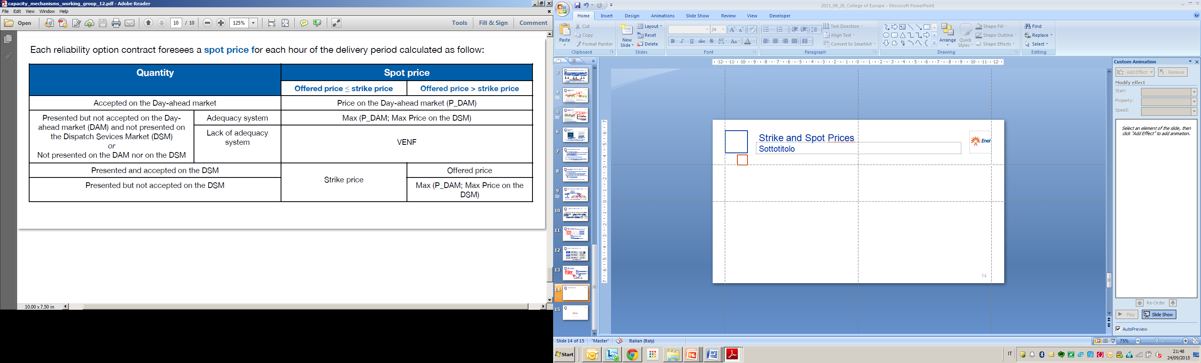
Spot and Strike Prices
DAM: System Marginal Price
DSM: Pay as Bid
VOLL
CO2 and GC
Single strike price for all accepted capacity, calculated on variable costs of peak technology – updated
Imbalance Costs
Note: the graph is illustrative, table from Terna

Slide 12
Thank you very much for your attention

